Slide 1

Preconference Session:
Oligonucleotide Therapeutics Educational Workshop 9:00 – 11:10
Chair:
Hassan Fakih, Ph.D., RNA Therapeutics Institute, UMass Chan Medical School

Slide 2





RNA eh!
The leading edge of the RNA revolution at McGill,
in Québec and across Canada
Thomas F. Duchaine, PhD
Professor and Chair, Department of Biochemistry
Professor, Rosalind & Morris Goodman Cancer Institute
Director, McGill Centre for RNA Sciences
OTS 2024 Meeting
October 6, 2024
Centre for RNA Sciences

Slide 3
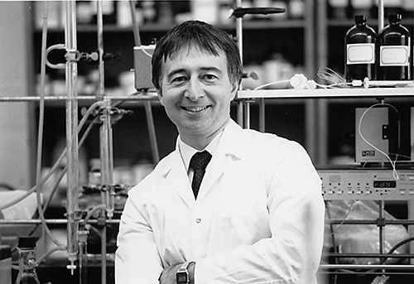
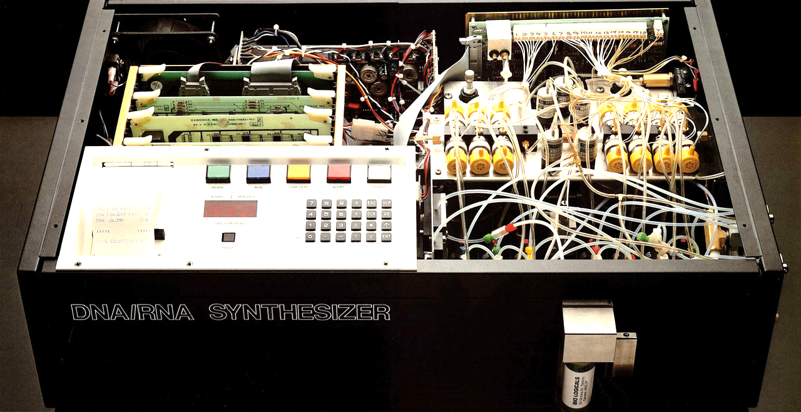
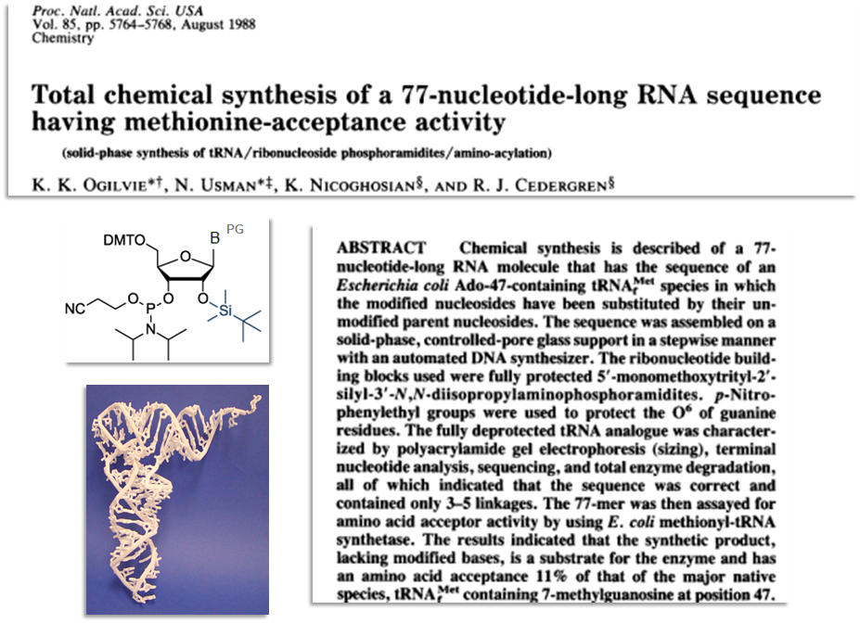
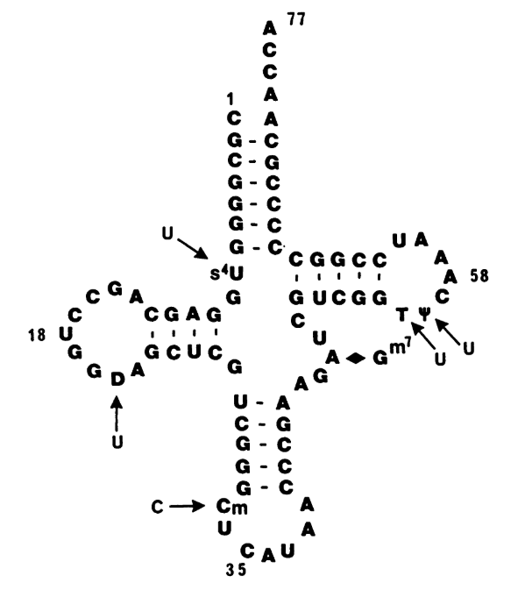
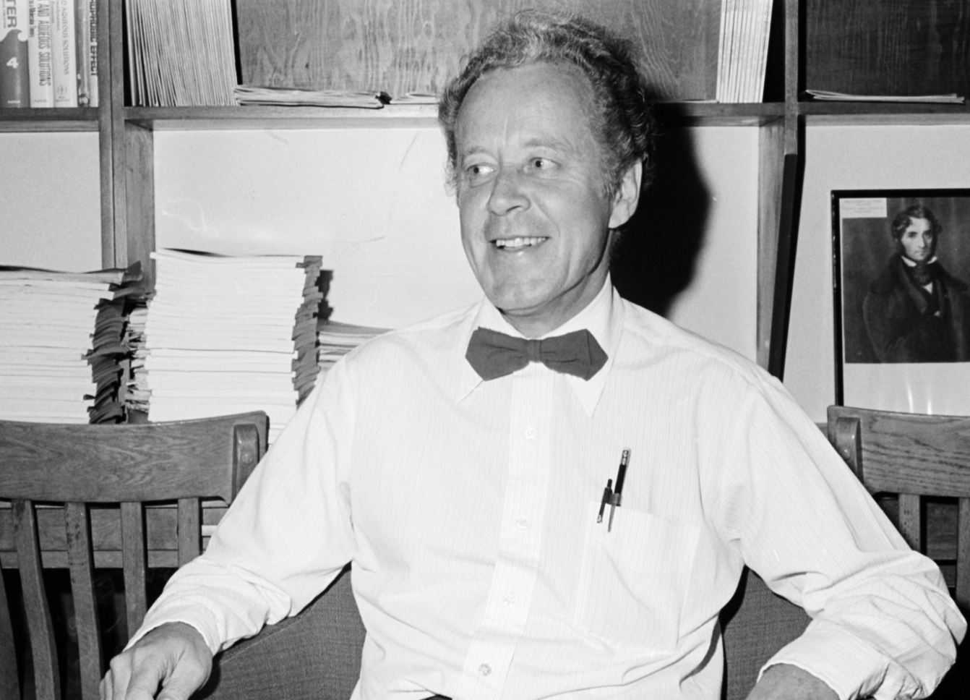
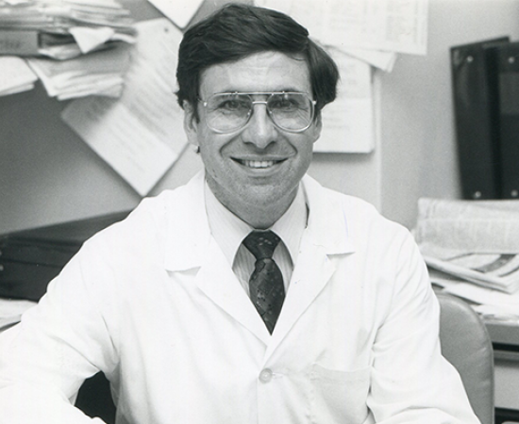
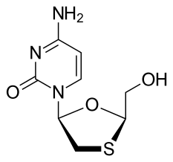


Early Breakthroughs in Nucleic Acids Chemistry and Medicine
at McGill University
TBDMS
Chemistry
Prof. Kelvin Ogilvie
(1942 -…)
The Gene Machine
Science 1981
tRNA^{Met}
Lamivudine
(3TC)
Ogilvie (Cedergren)
Total chemical synthesis of a tRNA
PNAS 1988
Prof. Bernard Belleau, Ph.D.
(1925-1989)
Prof. Mark Wainberg, M.D.
(1946-2017)

Slide 4
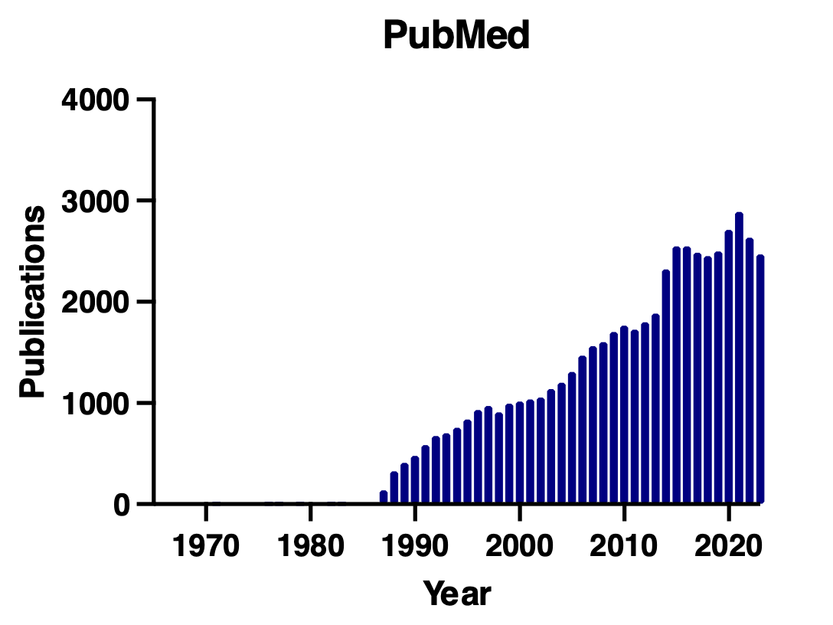
The Rapid Expansion of RNA Research in Canada
Search query: (RNA or mRNA) AND ("Canada"[Affiliation])

Slide 5
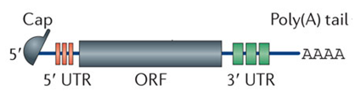



Some Key Discoveries and Advances in the Development
of mRNA as a Drug Technology
In vitro mRNA
Transcription
Lipid-Mediated
mRNA Delivery
Merix: 1st
mRNA-based
Company
m1Ψ - modified
mRNA enhances
translation
Cloning Cap1
Methyltransferase
Co-transcriptional
mRNA Capping
in vitro
Role of PKR
in Immune Innate
Response
mRNA is
Discovered
1st tRNA is
Sequenced
Cap Structure
is Discovered
Gene Machine
Invented
ssRNA Induces
TLR7 & TLR8
Protective VAX:
Flu and RSV mRNA
SARS-CoV-2 VAX:
Moderna/Pfizer
1961
1963
1965
1969
1975
1978
1981
1984
1985
1988
1989
1990
1997
2004
2005
2010
2012
2017
2020
Interferon
Induction by
mRNA
In vitro translation
of Isolated mRNA
IRES
is Discovered
mRNA Injected
Into Mice
Nucleoside-modified
mRNA is
not immunogenic
Characterization of IFIT1
Innate Immune
Response to mRNA
Role of Cap
in Translation
Cap-poly(A)
Synergy
Source: Prof. Jerry Pelletier, McGill

Slide 6
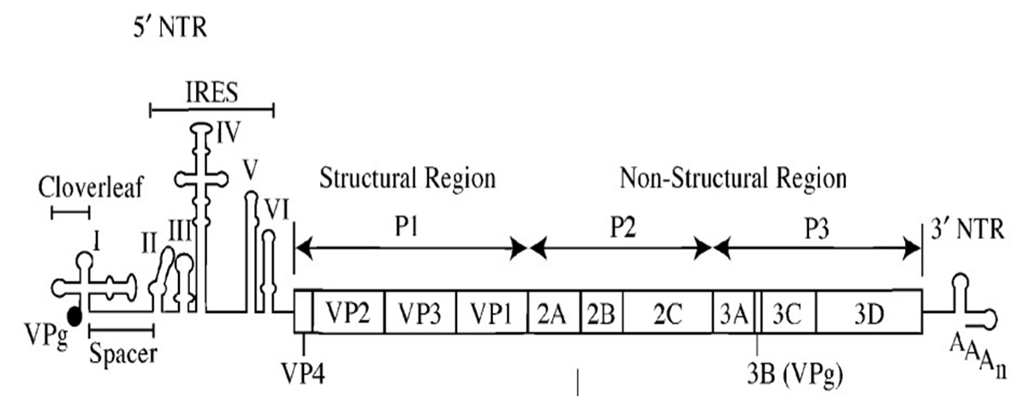
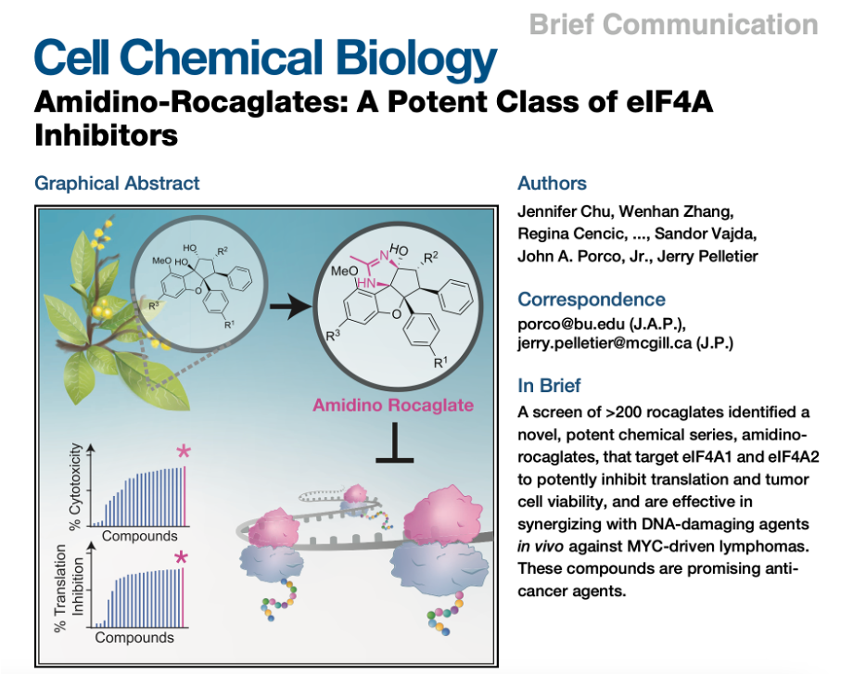
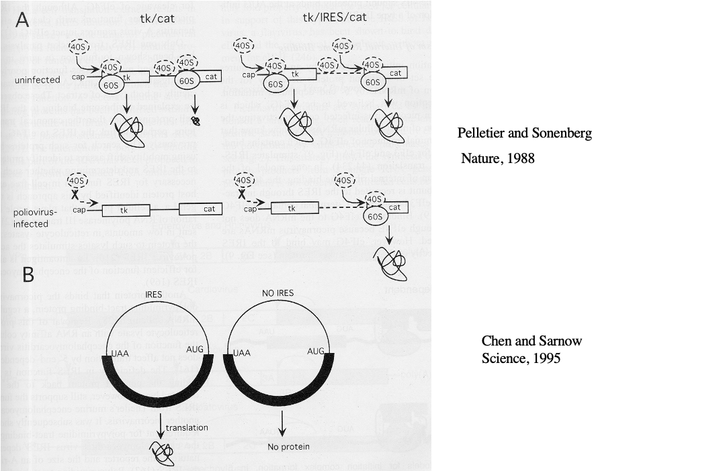
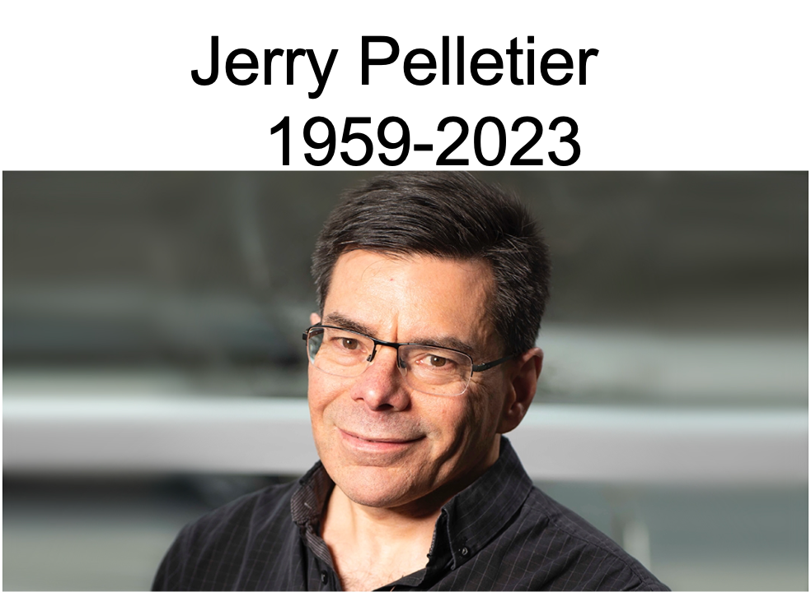
Profs. Jerry Pelletier & Nahum Sonenberg:
Two RNA giants at McGill
Internal Ribosome Entry Site
(IRES) Poliovirus RNA
Nahum
Jerry
Chu et al. (Porco, Pelletier)
Cell Chemical Biology 2019
Pelletier & Sonenberg
Nature 1988
(1959-2023)

Slide 7

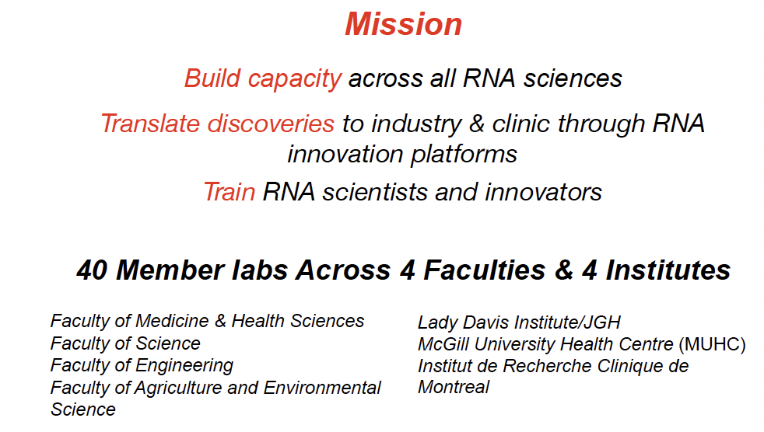
The McGill Centre for RNA Sciences
Founders: Profs. J. Pelletier, P. Gros, M. Damha

Slide 8
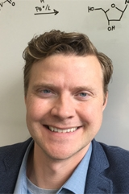
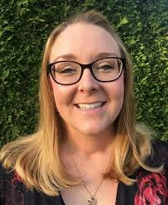

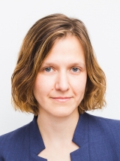
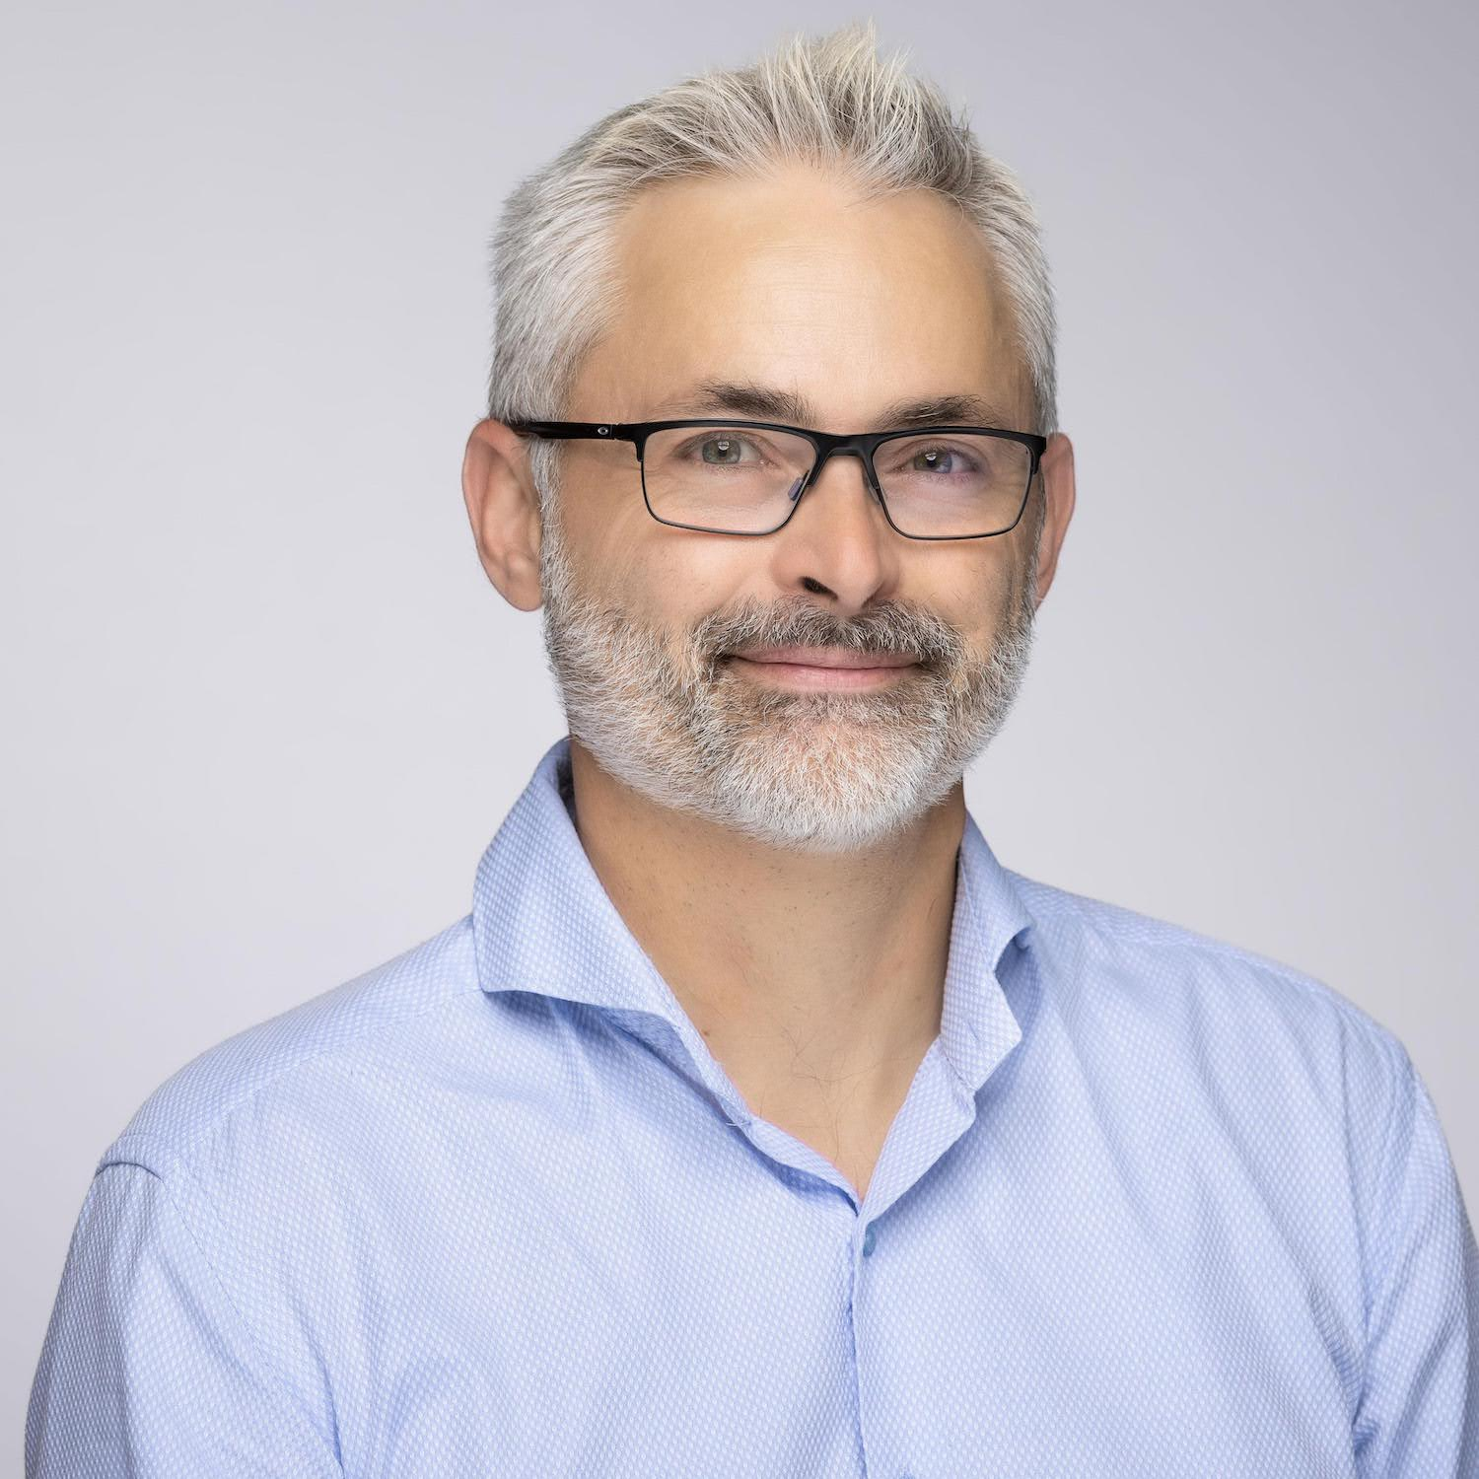
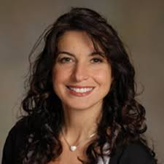
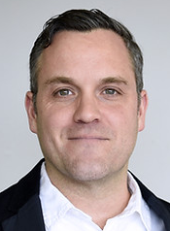
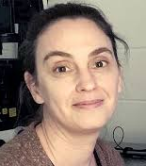

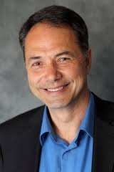
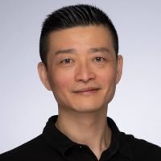
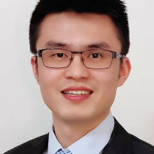
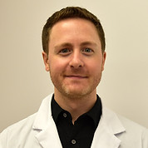
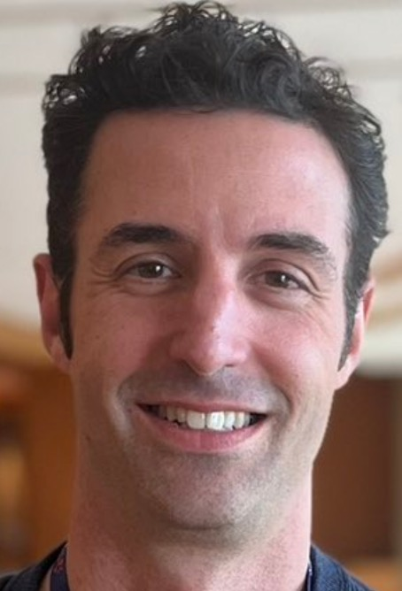
Some of our Groups Focusing on RNA Chemistry and Biology
Depts. of Chemistry, Biochemistry, Biomedical Engineering & Pharmacology
Maureen McKeague
Anthony Mittermaier
Thomas Duchaine
Hanadi Sleiman
Eric Lecuyer
Nathan Luedtke
Lena Simine
Biosensing / Synthesis
Aptamers, RNA
Biophysical Studies
Computation
RNA function
DNA nanotechnology
RNA localization
Maria Vera-Ugalde
Nic Moitessier
Martin Sauvageau
Marc Fabian
Masad Damha
Sidong Huang
Guojun Chen
Gene regulation
AI (Machine learning)
RNA therapeutics
Functional genomics
Drug delivery
lncRNA, gene regulation
RNA decay

Slide 9
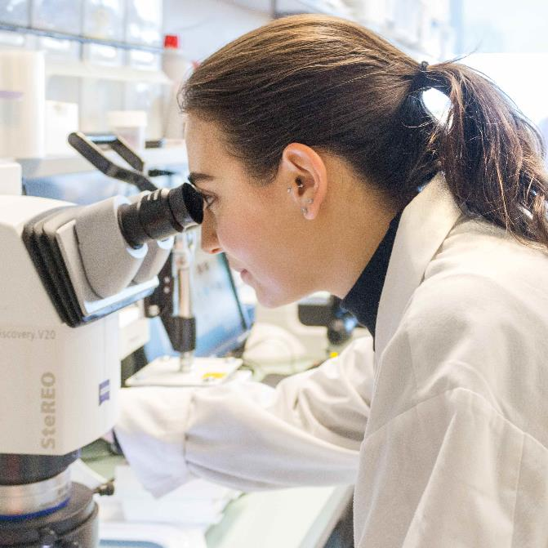

About D2R
Project: | D2R | DNA to RNA : An Inclusive Canadian Approach to Genomic-based RNA Therapeutics
Funding: | $165 million from the Canada First Research Excellence Fund $191 million commitment from Industrial Partners Overall 356+ million Program
Period: | 2023-2030

Slide 10
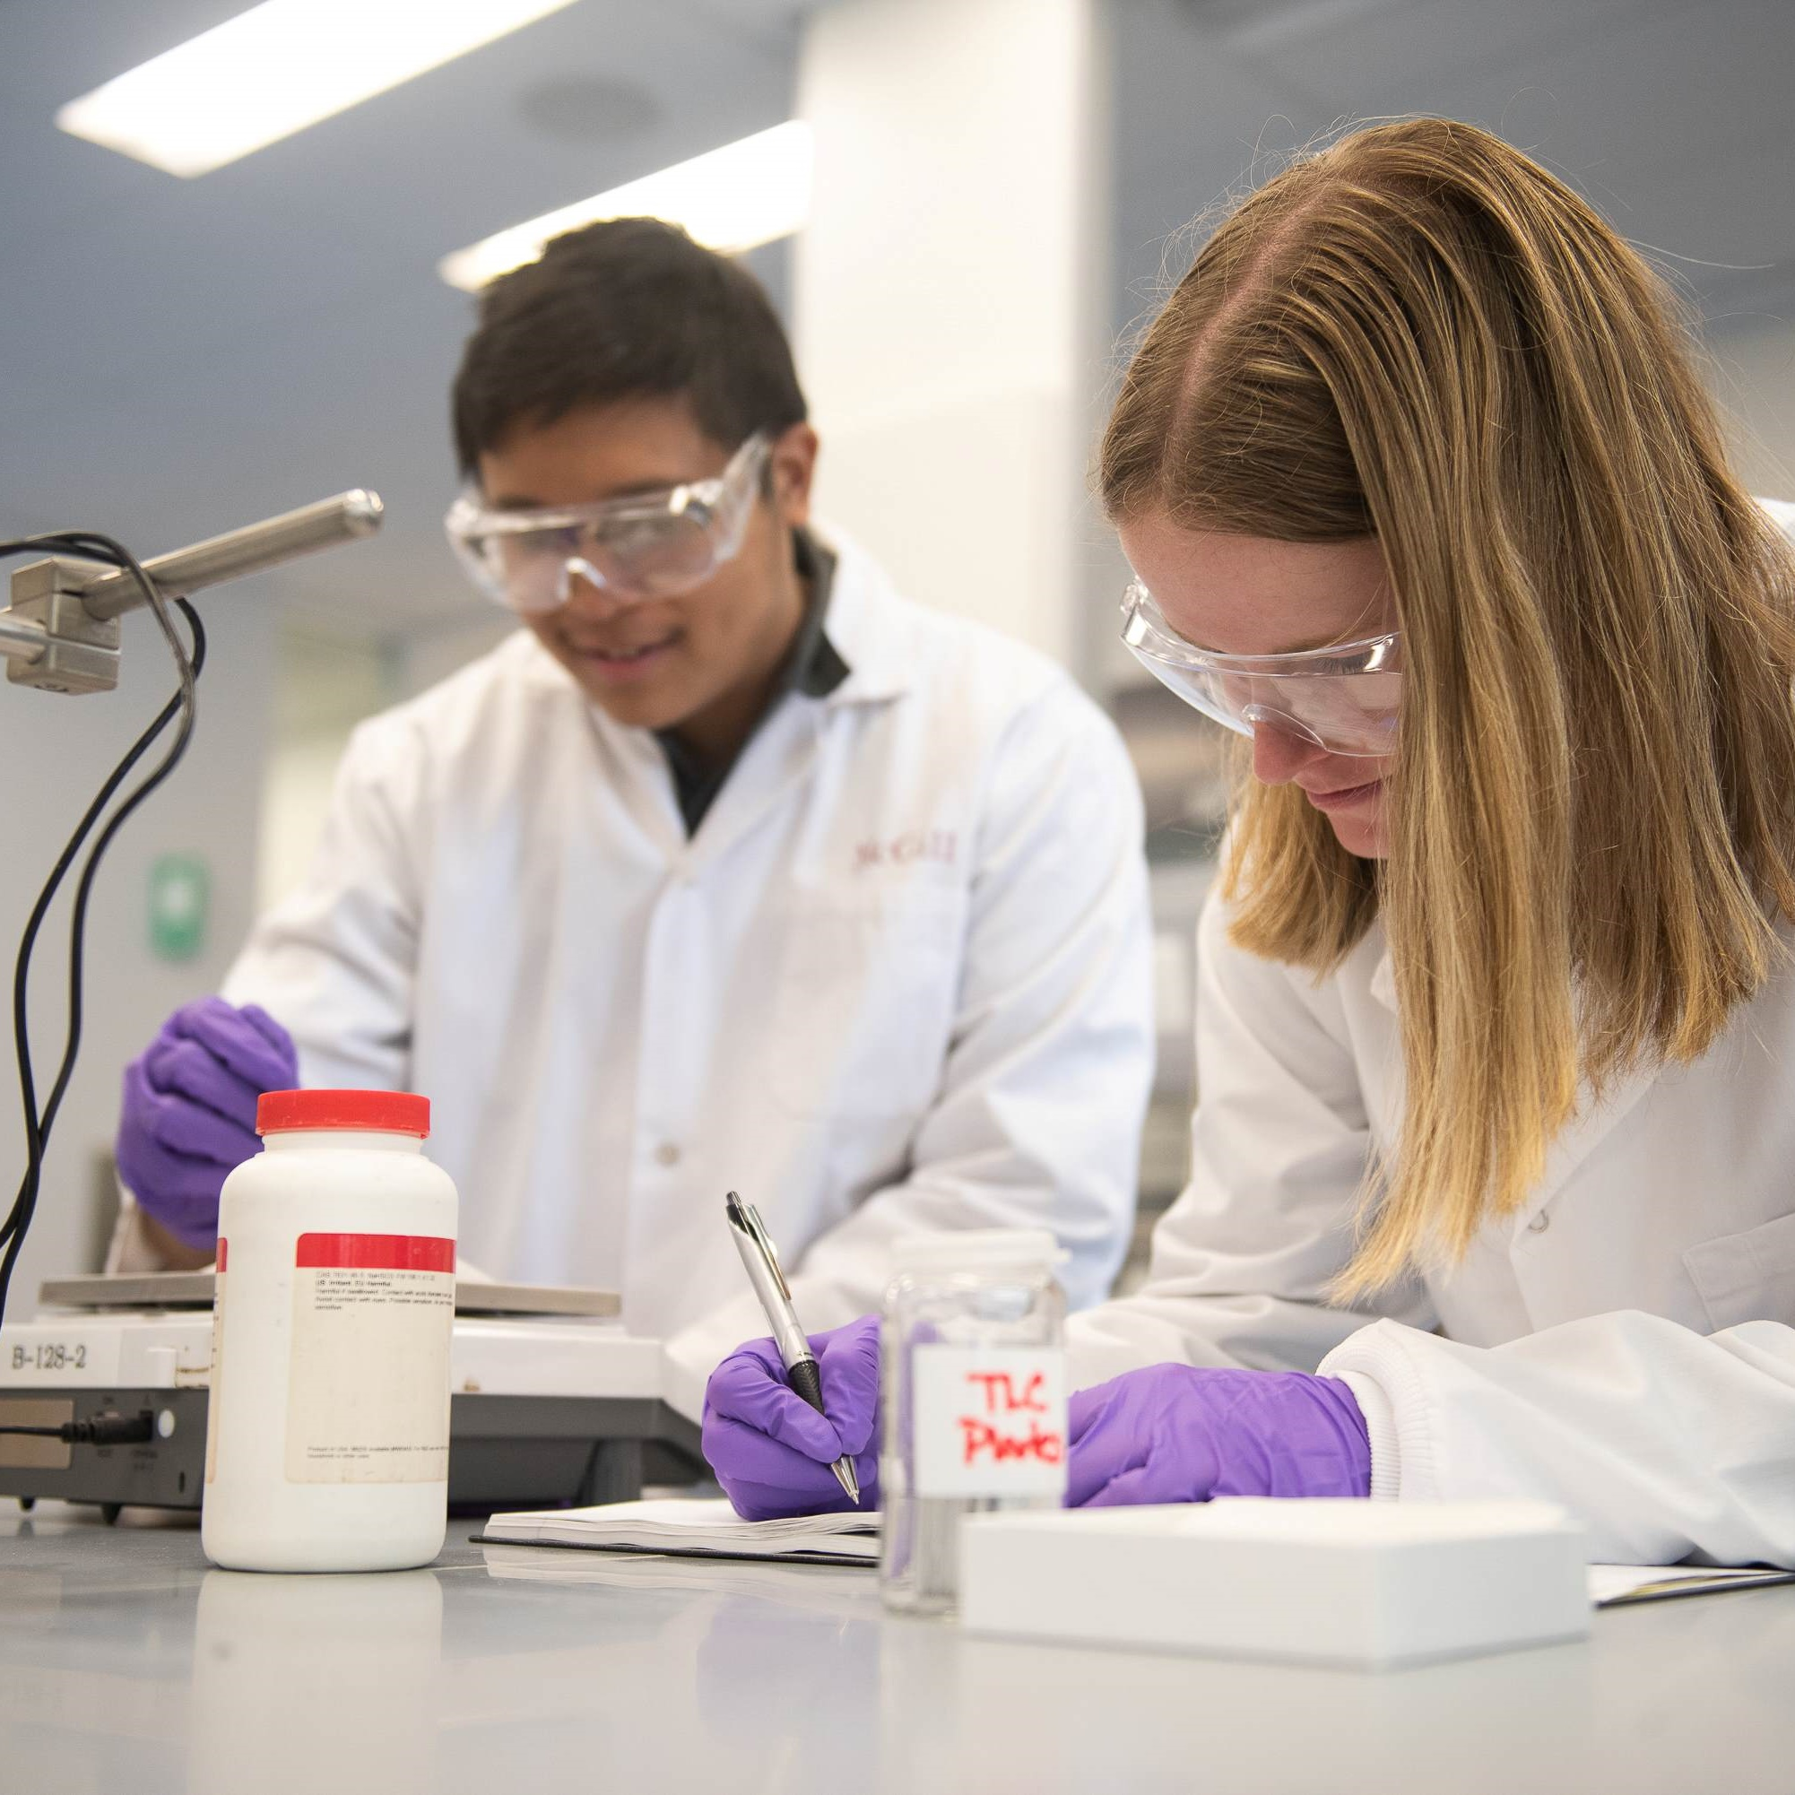
vISION
To deliver genomic-based RNA therapies to benefit the health of different populations affected by infectious, rare and neglected diseases, or those who have common chronic diseases such as cancer.

Slide 11
Priority diseases & Foundational Axes
Foundational Axes:
Population Studies and Genomic Medicine
RNA Therapeutics
Bioprocessing, Biomanufacturing and Nanotechnology
Clinical Research, Acceleration and Implementation
Data Science, Bioinformatics and Statistics in Personalized Medicine
Ethical, Socioeconomic, and Cultural Dimensions in Genomic Research
Priority Disease Areas:
Infectious diseases
Precision oncology
Rare diseases

Slide 12
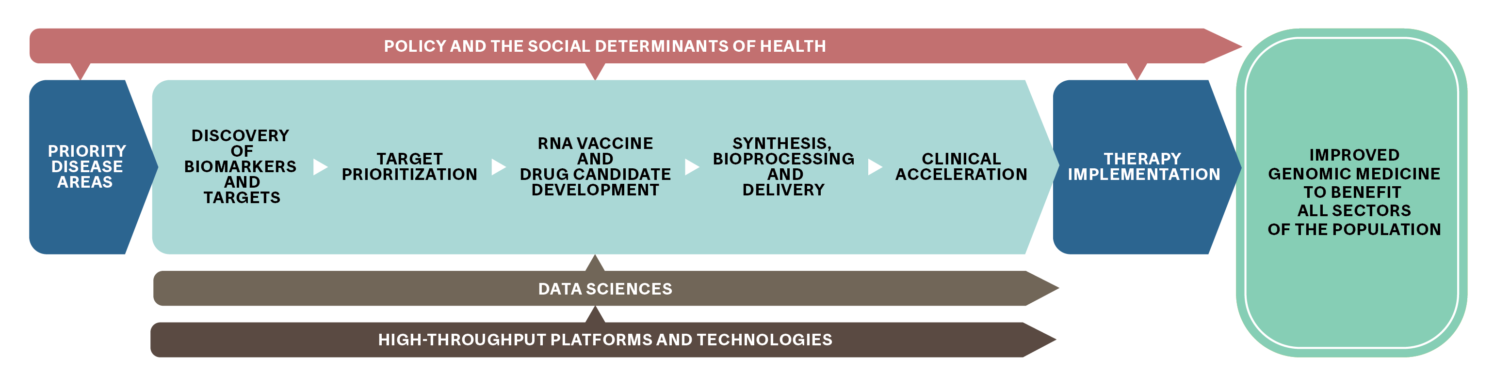
Research Framework & Funding Programs
Goals:
Address gaps and needs along the “translational spectrum”
Support new ways of doing research : 13 funding programs - 3 specific for industry

Slide 13


















































PARTNERS
Private Sector
Academic Institutions
Public Sector
Canadian
Attractivity of the academic-industry interface
Strong clinical research and knowledge translation partnership
Globalization of the effort
International

Slide 14
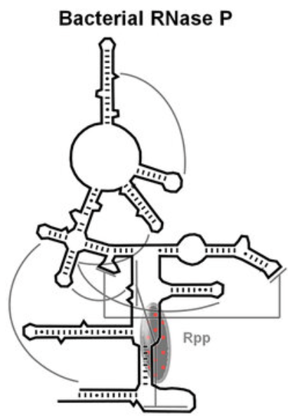
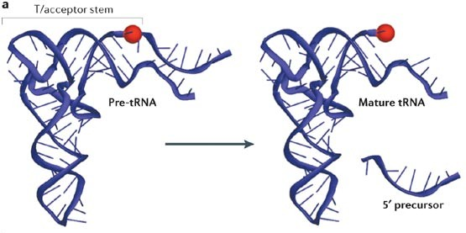
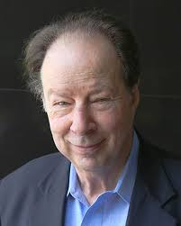
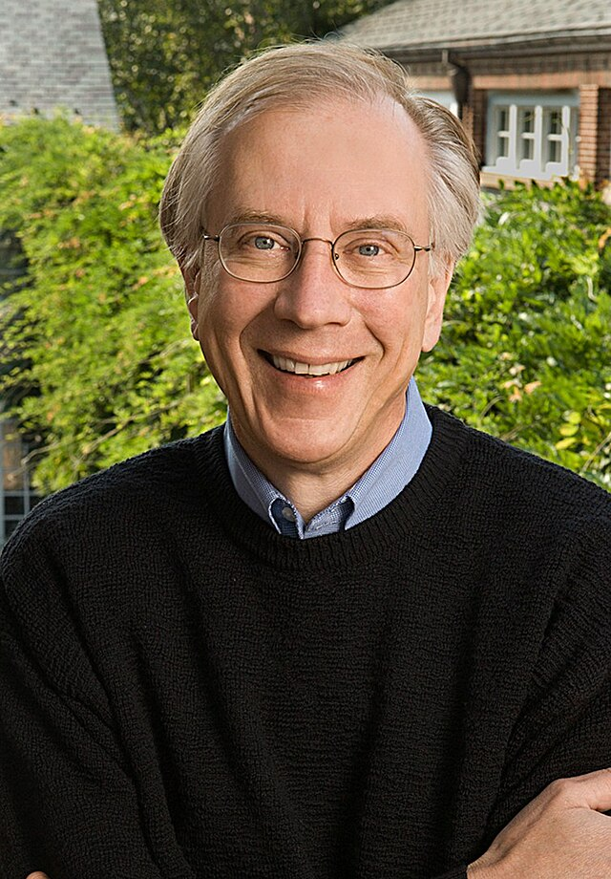
Altman and Cech
RNA can function as enzymes
Rnase P
Pre-tRNA
Mature
tRNA
Sidney
Altman
Tom
Cech
Nobel Prize Chemistry 1989
“for their discovery of catalytic properties of RNA”

Slide 15




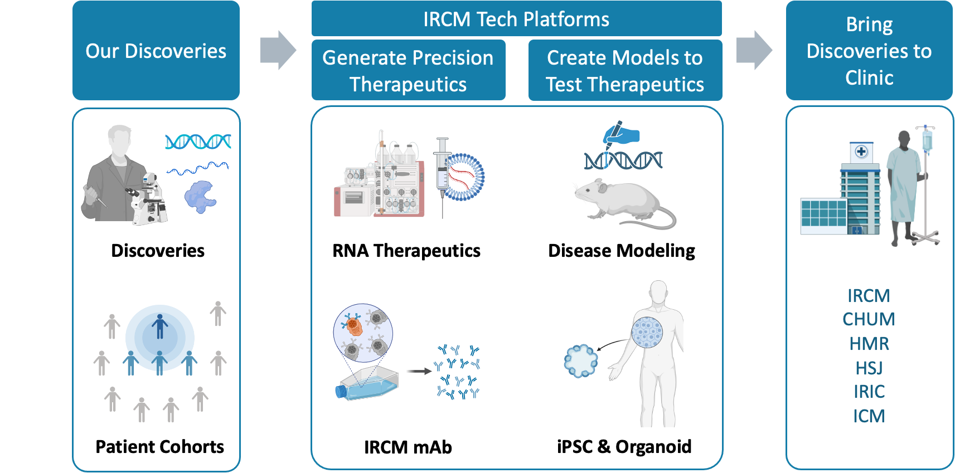

Slide 16














La Province de Québec:
Leveraging Momentum
& Critical Mass in RNA Research
>135
6
12+
16+
$24-31 B
RNA Labs
Universities
Centres & Institutes
Biotechs / Pharmas
Marché Global 2030
$356 M
Center for RNA Sciences
CELLULE
$2.5 M+
25 years

Slide 17
Stimulating innovation in Quebec's RNA therapeutics sector
Industrial Advisory Committee
Financing promising innovations
Pull
Specialized team to detect innovation in RNA medecine
Pharma
Funding partners
Researchers and SME of Québec
Venture capital
Looking for technologies answering industrial unmet needs
5 different Quebec’s funding agencies involved
Supporting up to $20M worth of projects
Mentors
R&D value creation
Scientific entrepreneurship
Push
Biotechs
Incubators

Slide 18












Québec RNA mobilizing project: 5 connected initiatives
aReNA: Outreach of the RNA sector
RNA competencies development
Biomanufacturing Services
Technology transfer & entrepreneurship
Innovation
funding & support
https://arenapole.ca/

Slide 19

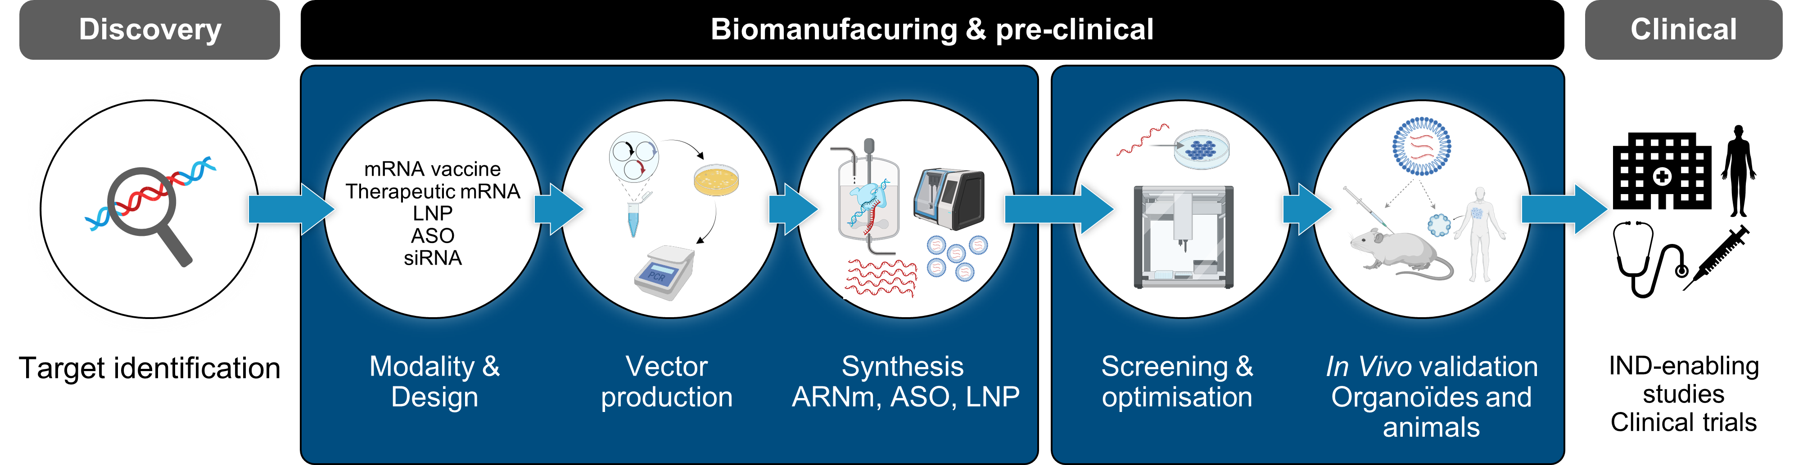
Rnomics Platform
Platforms for therapeutic development
and RNA biomanufacturing
Center for RNA Sciences
Sydney-Altman RNA Therapeutic Hub

Slide 20

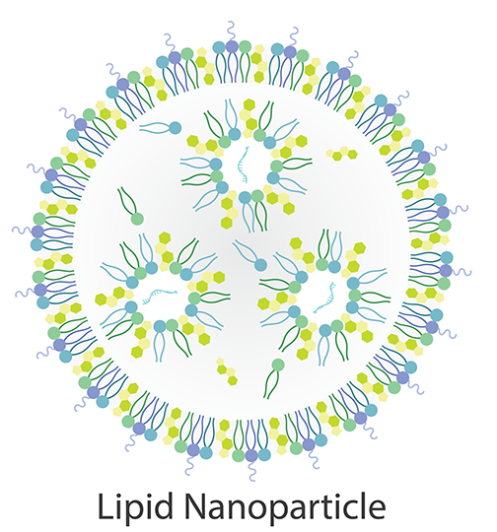

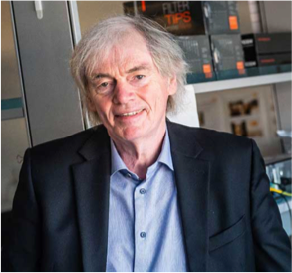
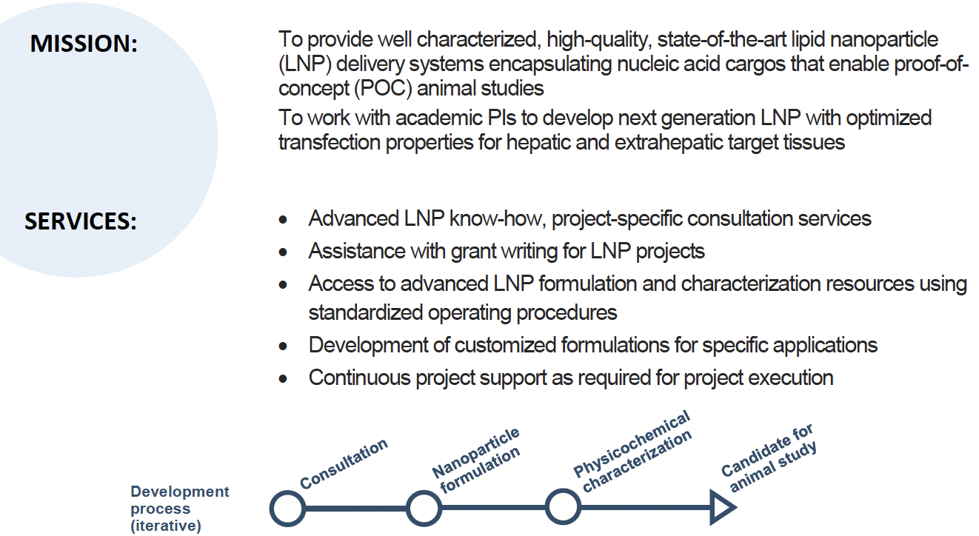
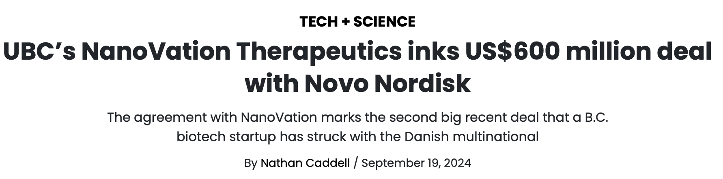

U. British Columbia & Prof. Pieter Cullis:
Delivering Lipid Nanoparticles and more…
Prof. Pieter Cullis, UBC
NanoVation, a platform company that is developing innovative technologies to overcome the barriers of nucleic avid delivery, announced a US$600 million multi-year partnership with the Danish multinational firm to advance the development of novel genetic medicines targeting cardiometabolic and rare diseases.

Slide 21




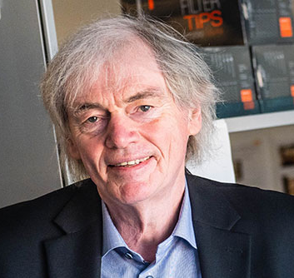
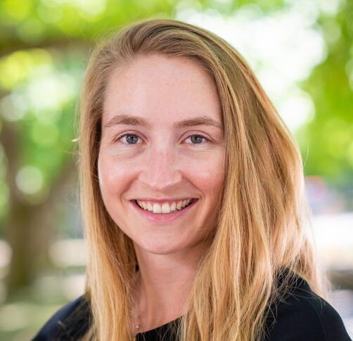



Advanced LNP RNA Vaccines Engineered with Next-Generation Designs to Enhance Pandemic Readiness
Establish domestic capacity for a 100-day response to a pandemic pathogen with next-generation RNA LNP technology
GOAL
1
Develop high-performing, fit-for-purpose RNA LNP vaccines with improved efficacy for at-risk populations
STRATEGY
2
Develop vaccine candidates against clinically relevant viral and bacterial pathogens
Co-Directors
3
Biomanufacture a lead candidate vaccine and test it in an NHP challenge model
Dr. Pieter Cullis
Dr. Anna Blakney

Slide 22
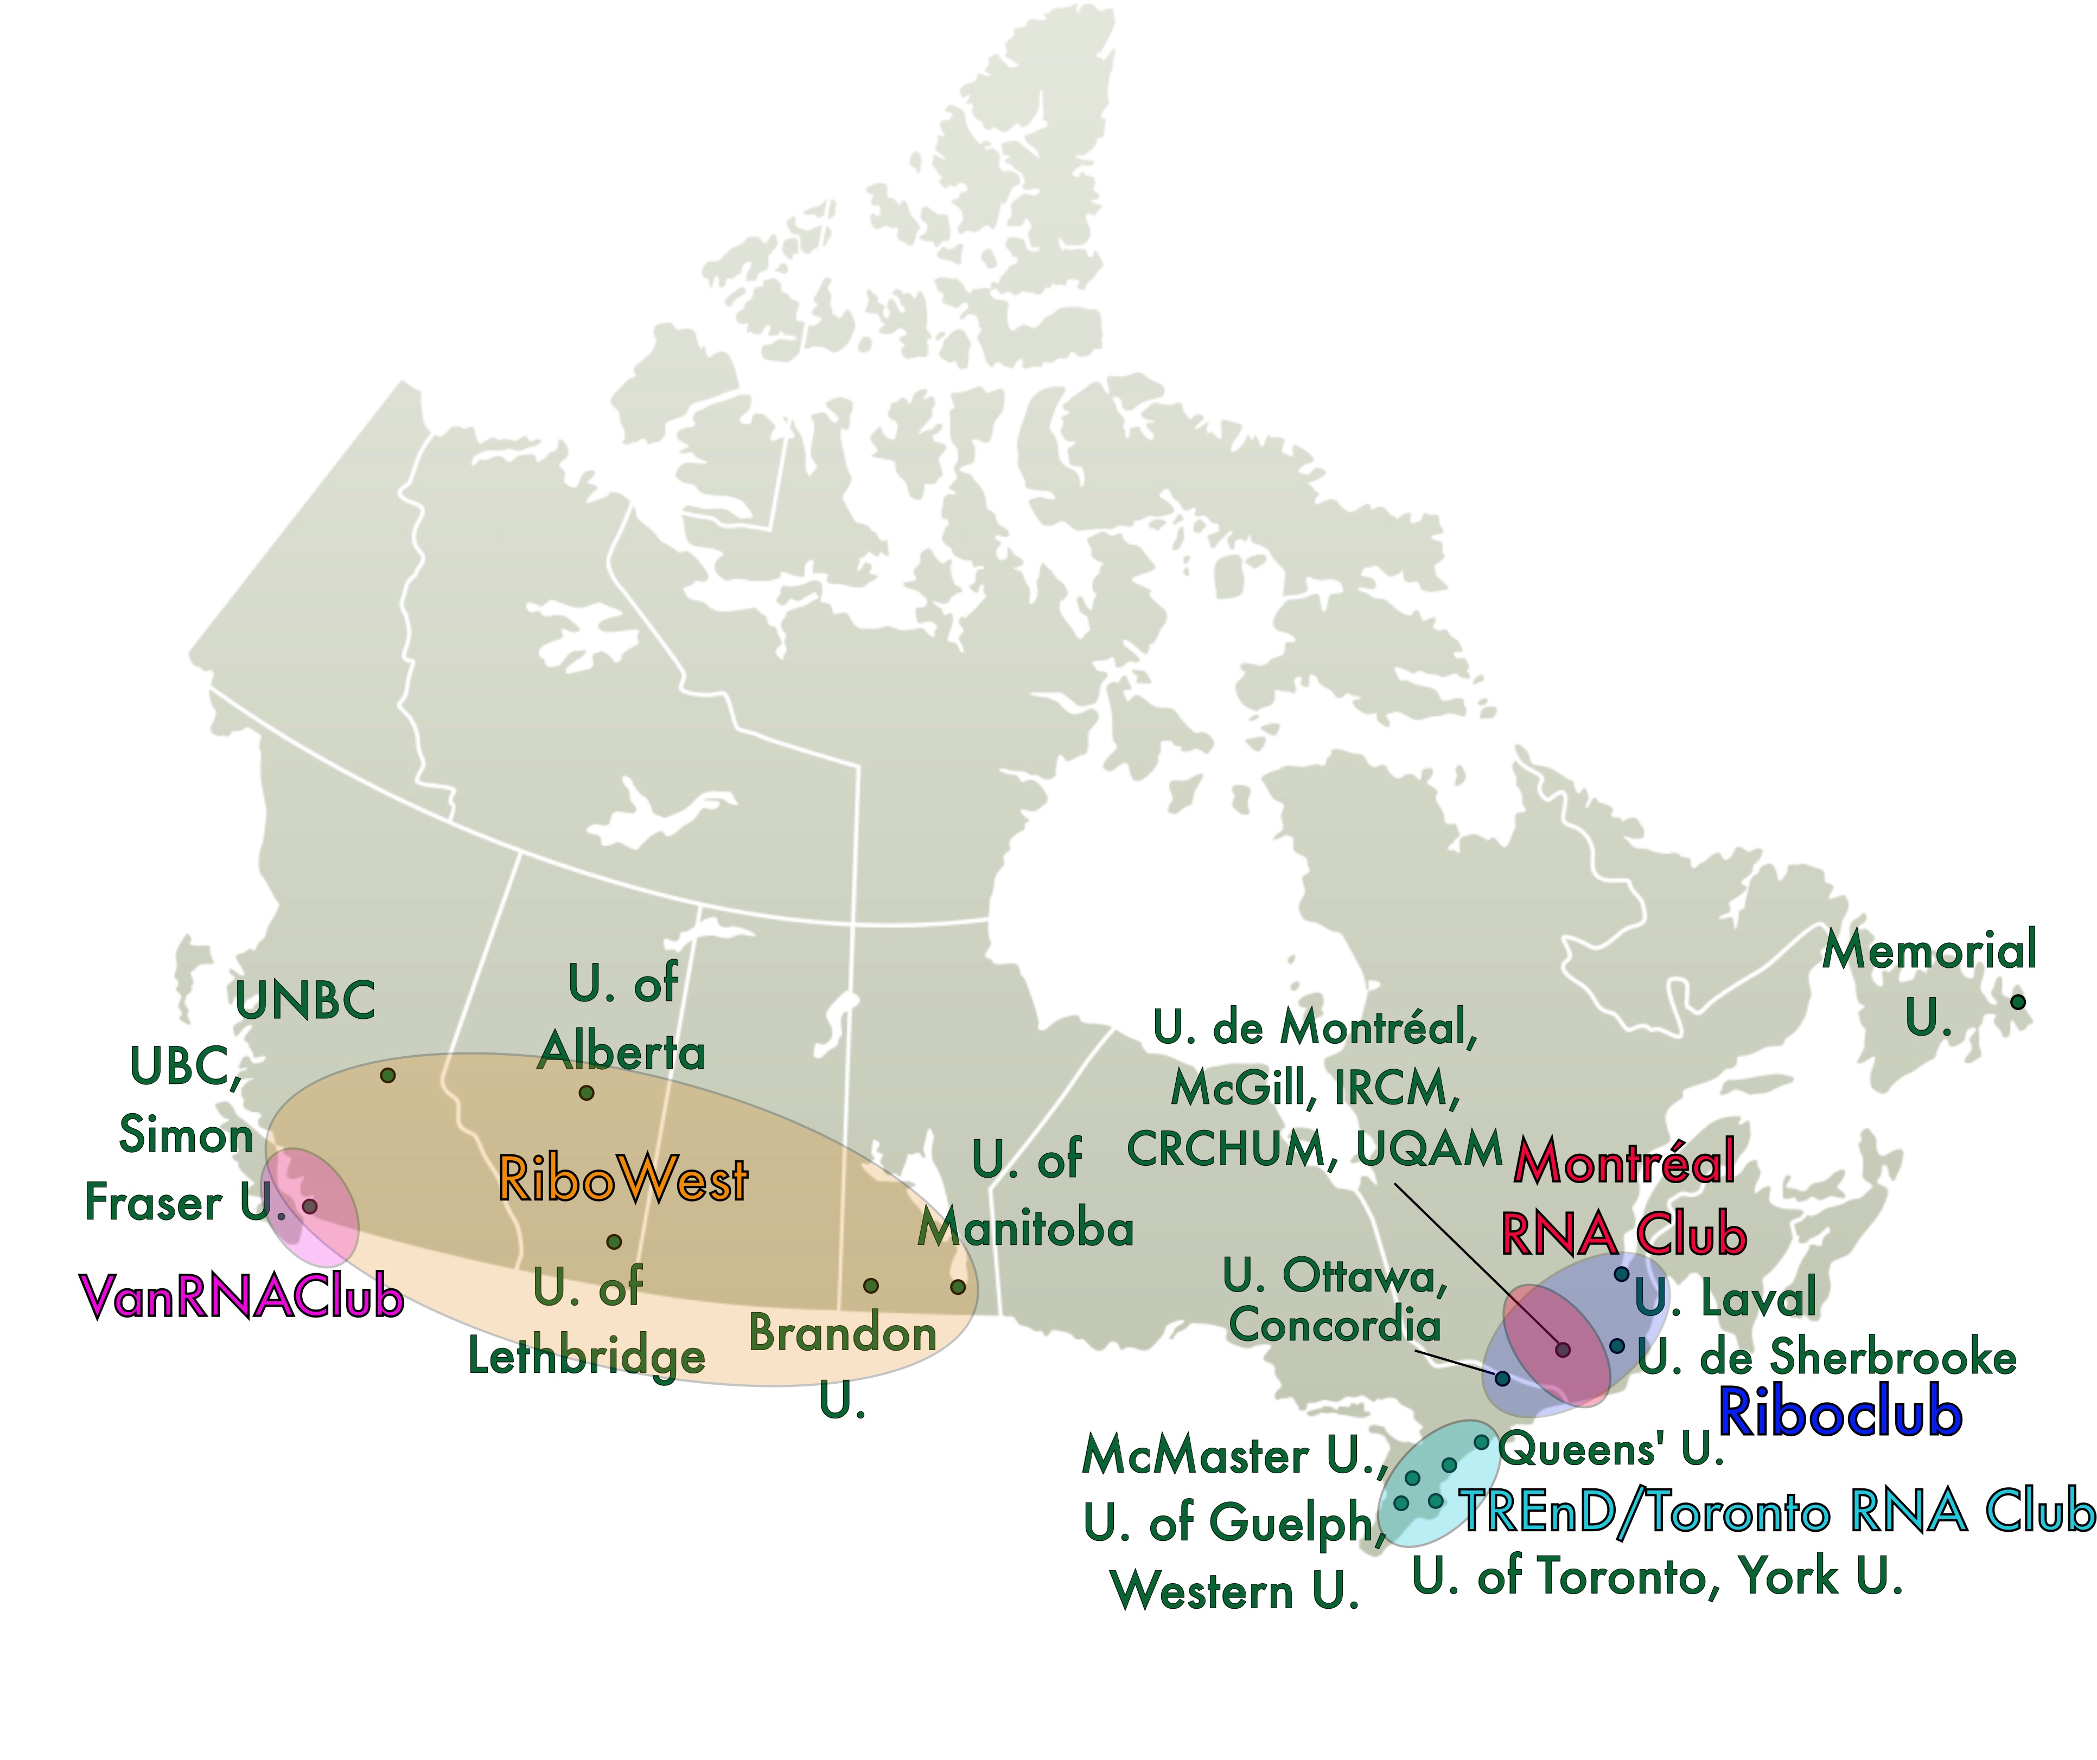

Altogether now…
Est. 2023

Slide 23
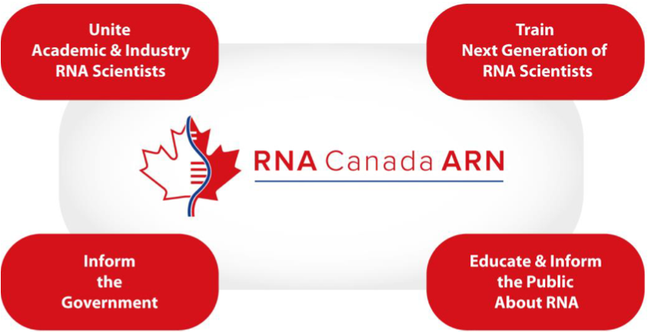
Vision
A grassroots, not-for-profit national organization regrouping academia and industry to:
Drive discovery, innovation
Advise government and funding agencies
Educate the public
Train the next generation of RNA scientists
Foster global collaboration
Meet evolving needs of Canada in RNA
Notes:
We envision a future where RNA technologies revolutionize health, agriculture, and environmental sustainability in Canada, supported by a nationally coordinated research community that drives innovation, fosters global collaboration, and meets the evolving needs of society.

Slide 24

RNA Canada: The Organization
Northern
Canada
Atlantic provinces
British Columbia
Created by ~700 trainees and principal investigators
RNA Alberta
ARN Quebec
Prairie (SK,MB)
Ontario
Adviced by an international Science and Industry Advisory Committee
Chair: John Mattick
Directed by 14 members board of directors
Chair: Howard Lipshitz – Vice Chair: Sean Mckenna - President: Sherif Abou Elela – Secretary: Julie Claycomb – Treasurer: Nehal Thakor
Membership & Analytics
Hosna Jabbari
EDI
Michelle Scott
Education
Marc Fabian
Meetings & Outreach
Mark Bayfield
Funding Coordination
Michael Strong
Industry Liaison
Jonathan Perreault
Volunteer base
Notes:
RNA Canada will be governed by an inclusive and at the same time slimmed down governing structure that ensures the participation of scientists and stakeholders from all regions (on the left), an elected Board of Directors (centre) which in turn will nominate members of the Executive Committee (centre) and a science and industry advisory Committee (right).

Slide 25








To learn more:
Centre for RNA Sciences
mcgill.ca/RNA/
thomas.duchaine@mcgill.ca
General enquiries:
D2R@mcgill.ca
mcgill.ca/D2R
Subscribe to
D2R’s mailing list
https://arenapole.ca/
Join

Slide 26
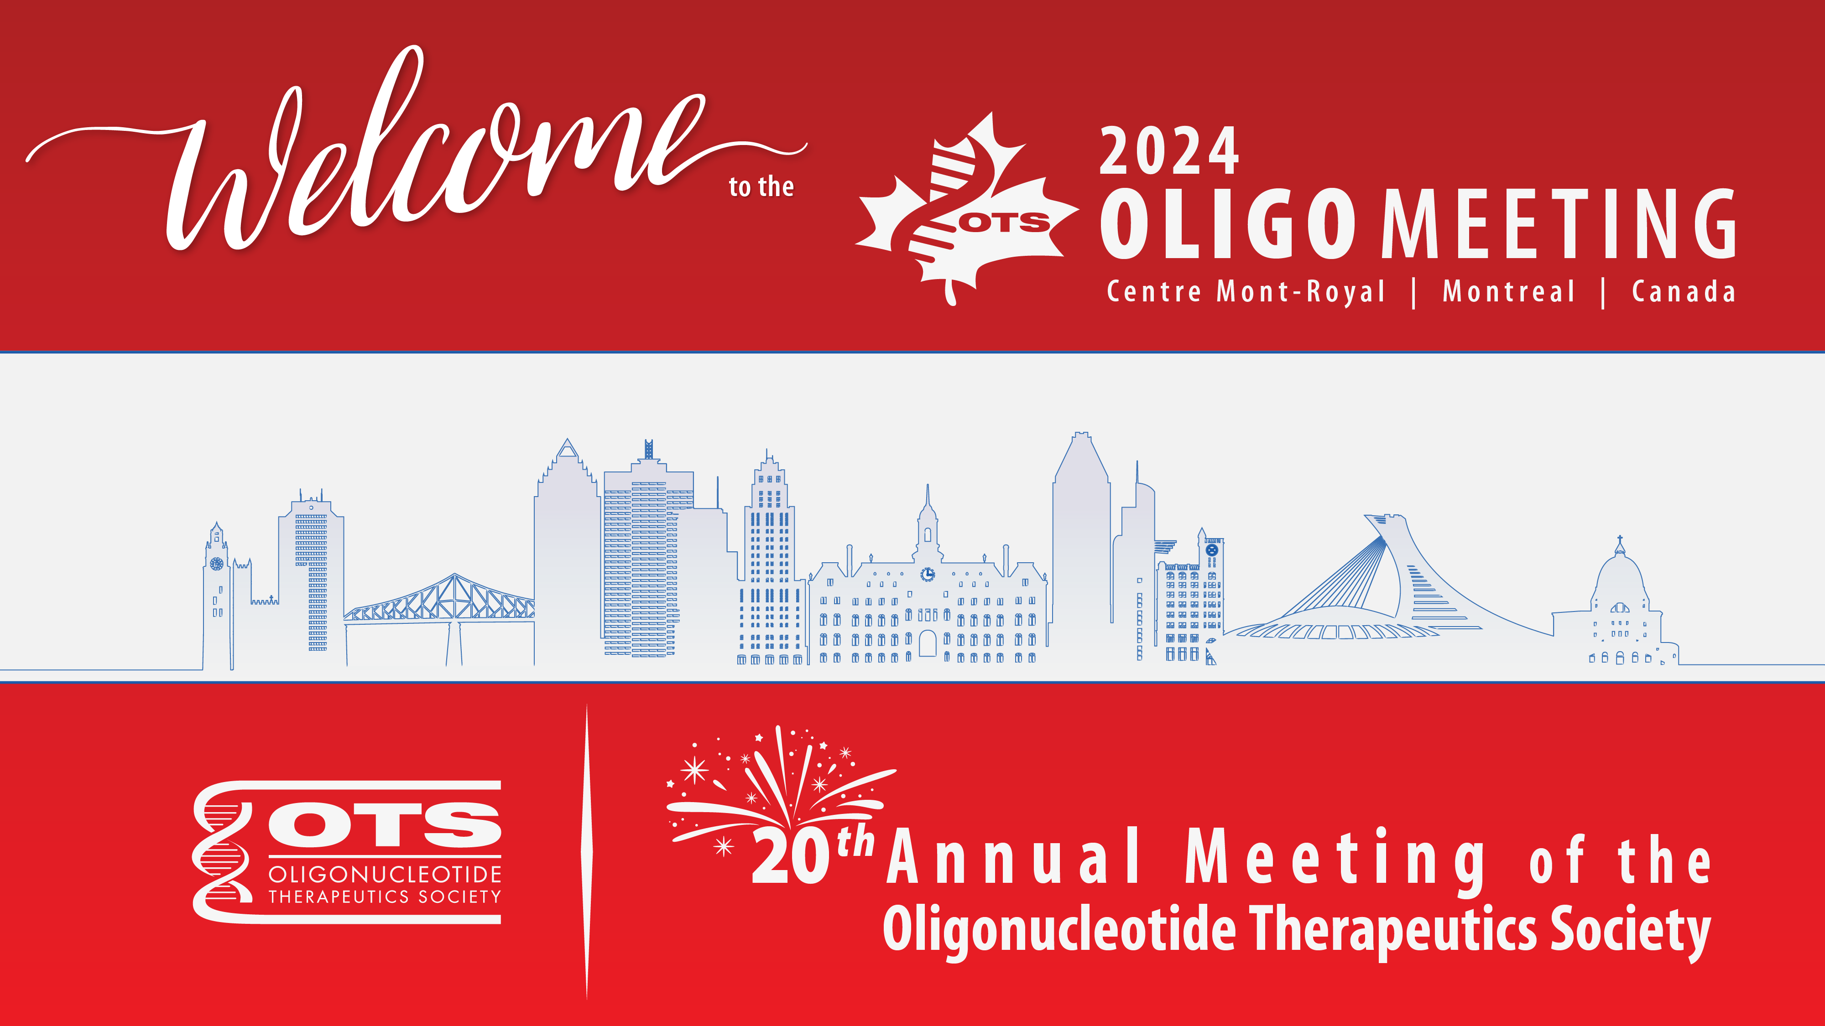

Slide 27
Selecting a Platform for Novel Oligonucleotide Clinical Bioanalysis: Assessing Benefits and Challenges
Rebecca Lescarbeau, PhD
OTS 2024

Slide 28







Therapeutic Strategies to Treat Life-Threatening Diseases Have Advanced Over Time
INNOVATION TIMELINE
Small Molecule Drugs
Biologics
RNAi
Gene Therapy
Genome Editing
PROTEINS
RNA
DNA

Slide 29
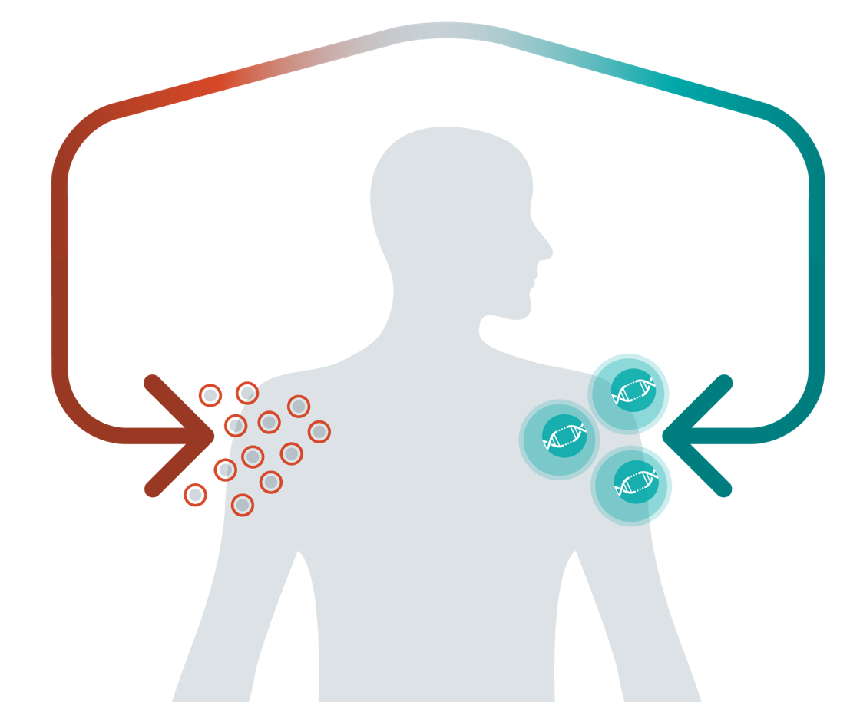
Advancing a Full-Spectrum Genome Editing Company
CRISPR-Based
Modular Platform
EMPLOY NOVEL EDITING AND DELIVERY TOOLS
In Vivo
Ex Vivo
CRISPR is the therapy
CRISPR creates the therapy
FIX THE TARGET GENE
REWIRE & REDIRECT CELLS
Genetic diseases
Immuno-oncology
Autoimmune diseases

Slide 30

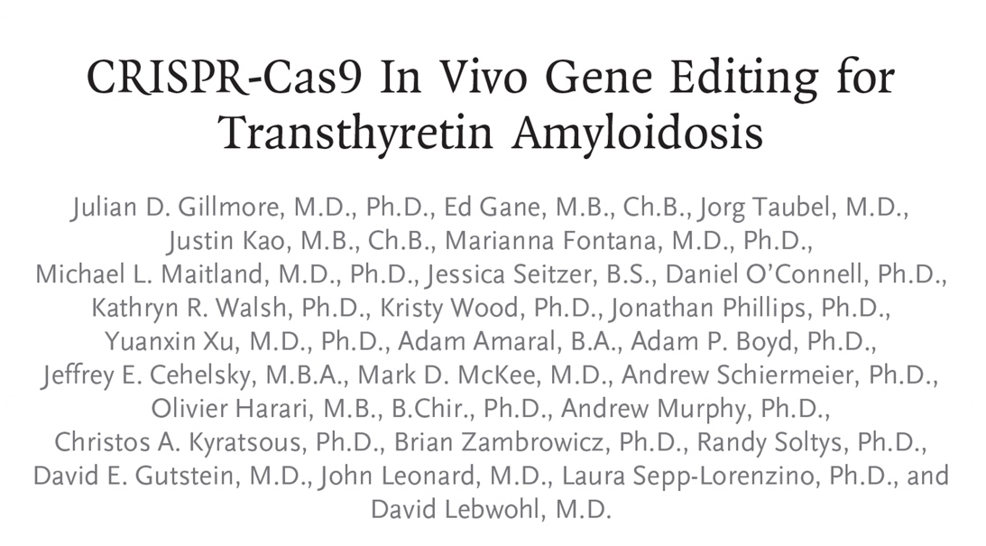
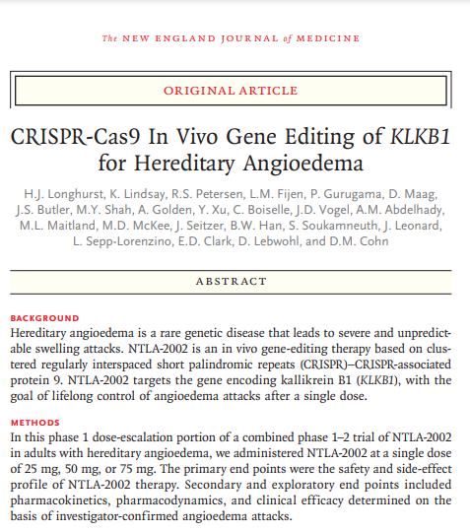
In Vivo Leader: First to Demonstrate Systemic CRISPR Gene Editing in Humans
August 5, 2021
January 31, 2024
Gillmore et al. New England Journal of Medicine 385:493-502 (2021)
Longhurst et al. New England Journal of Medicine 390: 431-441 (2024)

Slide 31
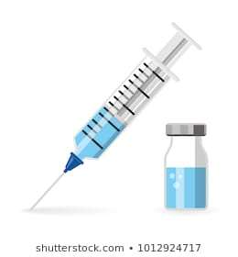
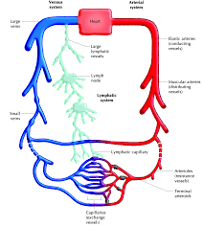
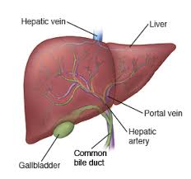


Evaluation of ADME Properties for New Therapeutic Modalities
Bioanalysis for non-clinical and clinical studies
PK, PD, Immunogenicity, and Biomarkers
ADME
Absorption (bioavailability, not needed for IV dosing)
Distribution, Metabolism, and Excretion
Enterohepatic
recirculation
Biliary excretion

Slide 32

Assessing PK of Novel In Vivo CRISPR/Cas9 Genome Editing Therapies
PK of gene therapy
Four components, as part of the LNP, were quantified to characterize PK
Lipid PK
RNA PK
RNA Drug Substances
Gene-specific sgRNA
Cas9 mRNA
Gillmore et al. New England Journal of Medicine 385:493-502 (2021)

Slide 33



Transient Exposure to LNP and RNA Cargo After Single Administration in NHPs
Ionizable Lipid​
sgRNA
Cas9 mRNA
Lipid Plasma
Lipid Liver

Slide 34
Considerations for Quantitating Oligonucleotides for Bioanalysis
Analysis Technique
Platform Selection
Reagent Needs
Linearity/ Range
Precision/ Accuracy
Limitations
What technique(s) will identify your oligonucleotide?
Are there platform-specific considerations for sample preparation?
Are there platform-specific considerations for reagents (IS; probes; mobile phase additives)?
What is your expected dynamic range? Will multiple dilution schemes be necessary?
Will the technique accurately and precisely measure the analyte concentration with desired sensitivity?
System setup;
Instrument redundancy/ downtime;
Batch/sample set up concerns

Slide 35
Oligonucleotide Quantification Method Landscape, some possibilities
Oligonucleotide Quantification
Amplification
Separation
qPCR/
RT-qPCR
dPCR/ddPCR/
RT-(d)dPCR
Chromatographic Fluorescence Detection
Liquid Chromatography-Mass Spectrometry

Slide 36


Polymerase Chain Reactions: Mechanism
qPCR
Quantitation: Interpolation of Ct from standard curve
Sample
Preparation
PCR
Amplification
Cycles
ddPCR/
dPCR
Quantitation: copies/rxn (droplet count with Poisson statistics) Interpolation of Ct from standard curve
Sample
Preparation
Droplet
Generation/ Sample Partitioning
PCR
Amplification
Droplet
Reading
Amplification
Plot
Quan et al. Sensors 18(4): 1271-1297 (2018)

Slide 37
Applications of PCR
Cell kinetics for Cell Therapy
Vector shedding for AAV Therapy
Oligonucleotide biodistribution
Transgene expression
Oligonucleotide drug substance pharmacokinetics
Minimal residual disease (oncology)
Other oncology uses: Prognosis, Diagnosis, Response

Slide 38
Cell Kinetics by qPCR
qPCR
YESCARTA® is a CD19-directed genetically modified autologous T cell immunotherapy
Chimeric Antigen Receptor T Cell (CAR-T)
Approved for adults with r/r large B-Cell lymphoma (2L+)
Dose: 2×10⁶ (CAR)-positive viable T cells per kg body weight
Maximum of 2×10⁸ CAR-positive viable T cells
Cell Kinetics by qPCR
Assay LOD: 0.001% (1x10⁻⁵)
Reported units: cells/µl of blood
Matrix: Peripheral blood mononuclear cells
U.S. Food and Drug Administration. Package Insert and Medication Guide YESCARTA. Kite Pharma, Inc. 2024. https://www.fda.gov/media/108377/download

Slide 39
qPCR Cell Kinetics Methodology
qPCR
Unique primer/probe set: Anti-CD19 CAR
DNA Extraction from PBMC
Amplification and Detection
Standards: CAR-T DNA spiked pre-treatment patient DNA
Sample Quantitation by Interpolation to Std Curve and unit conversion
Kochenderfer et al. Blood. 119(12): 2709–2720 (2012).
Locke et al. Molecular Therapy. 25(1): 285-295 (2017).
Locke et al. New England Journal of Medicine. 386: 640-654 (2022).

Slide 40

Cell Kinetics of Yescarta® by qPCR Presence, expansion, and persistence in blood
qPCR
qPCR well suited to capture multi-log expansion and contraction, typical of CAR-T therapy
CAR-T cells measured as copies/ug DNA and converted to µL blood (WBC count; # CAR/CAR-T Cell)
CAR T Cells in Blood (Cells/µL)
Time After Infusion
Phase 3, 180 Treated Participants
Locke et al. New England Journal of Medicine. 386: 640-654 (2022).

Slide 41
Vector Shedding and Biodistribution of AAV by qPCR
qPCR
LUXTURNA™ (AAV2-hRPE65) is an adeno-associated virus vector-based gene therapy
Indication: biallelic RPE65 mutation-associated retinal dystrophy
Dose: 1.5x10¹¹ vg/eye (0.3 mL); subretinal injection
Vector Shedding by qPCR
Assay sensitivity: 10 copies/µg DNA
Assay applicability:
Matrices: Fluids and tissues
Species: Human, non-human primate, and dog
U.S. Food and Drug Administration. Package Insert Luxturna. Spark Therapeutics, Inc. 2024. https://fda.gov/media/109906/download.
Swissmedic, Swiss Agency for Therapeutic Products. Swiss Public Assessment Report LUXTURNA. 15 April 2020. https://www.swissmedic.ch/dam/swissmedic/de/dokumente/zulassung/swisspar/67371-luxturna-01-swisspar-20200415.pdf.download.pdf/2020-04-15_SwissPAR_Luxturna-FINAL.pdf

Slide 42
Nonclinical Biodistribution of AAV by qPCR PCR is well suited for analysis from multiple matrices (DNA extraction)
qPCR
Dog
AAV Detected in multiple organs
Non-human primate
AAV Detected in multiple organs
Subretinal injection
Subretinal injection
Eye: Vitreous and anterior chamber fluids
Eye
Timepoints: 3 weeks and 3 months post dose
Timepoint: 3 months post dose
Optic Nerve
Preauricular lymph nodes
Various lymph nodes
Colon, duodenum, stomach
Optic nerve
Liver
Spleen
Technical challenges for liver and lung, N/A
Trachea
BQL: Gonads
U.S. Food and Drug Administration. Package Insert Luxturna. Spark Therapeutics, Inc. 2024. https://fda.gov/media/109906/download.
Swissmedic, Swiss Agency for Therapeutic Products. Swiss Public Assessment Report LUXTURNA. 15 April 2020. https://www.swissmedic.ch/dam/swissmedic/de/dokumente/zulassung/swisspar/67371-luxturna-01-swisspar-20200415.pdf.download.pdf/2020-04-15_SwissPAR_Luxturna-FINAL.pdf

Slide 43
Clinical Vector Shedding of AAV by qPCR
qPCR
Systemic exposure (serum pos) seen from some patients after subretinal injection
Assay principles remain the same from nonclinical to clinical use
 | Unilateral Injection |  |  | Bilateral Injection
 | Injected Eye | Un-injected Eye
Tears | 45% of Subjects: low, transient levels | 7% of Subjects: positive until Day 3 |  | 45% of Subjects: vector detected Day 1
 |  |  |  | Majority had no detectable DNA by Day 3
Serum |  |  |  | 10% of Subjects: positive
U.S. Food and Drug Administration. Package Insert Luxturna. Spark Therapeutics, Inc. 2024. https://fda.gov/media/109906/download.

Slide 44
qPCR or dPCR? Benefits and Challenges
qPCR
dPCR
Dynamic Range | 8+ Log₁₀ | 4 Log₁₀; lower ULOQ
Sensitivity/rare event quantitation | High | Very High
Quantitation | Std Curve Interpolation (R² and Slope criteria) | Absolute (droplet count with Poisson statistics)
Plate format | 384 | 24 up to 96*4
Detectable Foldchange | 1.25-1.50x | 1.2x
Susceptible to PCR inhibition | Higher | Lower
Amplification Reliance | Higher | Lower
Precision | High | Very high
Dilution Linearity | Good | Very good
Industry Comfort for Validated Assays | High | Good, growing
Robustness | High | Good
Instrument Validation Comfort | High | Good, growing
Hays et al. The AAPS Journal 26(24):1-31 (2024); Corsaro et al. Bioanalysis 13(6): 415-463 (2021); Pan et al. Bioanalysis 15(14): 773-814 (2023); Loo et al. Bioanalysis 14(11): 737-793 (2022); Wissel et al. Bioanalysis 14(12): 853-863 (2022); Huggett et al. Clinical Chemistry 59(6): 892–902 (2013)

Slide 45
Overarching PCR Themes qPCR and dPCR Considerations
qPCR
&
dPCR
QCs (High, Mid, Low) and NTC
Reverse-transcription workflows available
Primers and probes are critical reagents and should be purified and nuclease free
LLOQ <50 copies/ug gDNA
Copy No./ug nucleic acid reported generally; but copy/volume matrix could be used with justification (copy/µL blood for cell kinetics)
NTC (water wells) and blank matrix/background DNA/RNA should be tested
Interference with multiplexing possible, define variability separately
Restriction enzymes may improve quantitation
Sample preparation similar for tissue homogenization/cell lysis/DNA extraction
Similar validation plans, but criteria will be platform dependent
Hays et al. The AAPS Journal 26(24):1-31 (2024); Corsaro et al. Bioanalysis 13(6): 415-463 (2021); Pan et al. Bioanalysis 15(14): 773-814 (2023); Wissel et al. Bioanalysis 14(12): 853-863 (2022); Huggett et al. Clinical Chemistry 59(6): 892–902 (2013); Sun et al. Bioanalysis 15(17):1069-1081 (2023)

Slide 46




Chromatographic Separation and Analysis
Fluorescence Signal with chromatographic separation from metabolites (n-1, n-2)
Chromatographic Fluorescence Detection
Quantitation: Interpolation from standard curve
Sample
Preparation
Probe Binding
LC-Fluorescence
Analyte
Internal Standard
LC-MS
Quantitation: Interpolation from standard curve; IS correction
Sample
Preparation
IS Addition and Oligonucleotide Extraction
LC-MS (High Res)
Ramanathan and shen. Bioanalysis 11(21): 1983–1992 (2019);
Wuxi Apptec. Application of Liquid Chromatography-Fluorescence (LC-FL) Detection Methods for DMPK Quantitative Bioanalysis of Oligonucleotides. 2023. https://dmpkservice.wuxiapptec.com/articles/21-application-of-liquid-chromatography-fluorescence-lc-fl-detection-methods-for-dmpk-quantitative-bioanalysis-of-oligonucleotides/

Slide 47
Pharmacokinetics by ATTO-probe/ HPLC-Fluorescence Detection
Chromatographic Fluorescence Detection
ONPATTRO® (patisiran) is a lipid complex injection, for intravenous use
Approved for adults with ATTR-PN
Small interfering RNA Drug Substance (ALN-18328)
Dose: 0.3 mg/kg up to 30 mg; every 3 weeks by intravenous infusion
PK by Fluorescence Detection
Limit of quantification (LLOQ): 1 ng/mL
Precision (CV%): 9.1%
Accuracy Range: -2.7%-2.5%
U.S. Food and Drug Administration. Label Onpattro. Alnylam Pharmaceuticals, Inc. 2018. https://www.accessdata.fda.gov/drugsatfda_docs/label/2018/210922s000lbl.pdf

Slide 48
Fluorescence Methodology
Chromatographic Fluorescence Detection
Unique probe: Complementary to strand of interest
Plasma Preparation
Probe Annealing
Separation and detection: ion exchange HPLC and fluorescence
Sample Quantitation by Interpolation to Std Curve
Zhang et al. The Journal of Clinical Pharmacology., 60(1) 37–49 (2020); Coelho et al. New England Journal of Medicine. 369(9):819-829 (2013).

Slide 49


Drug Substance Pharmacokinetics by Fluorescence
Chromatographic Fluorescence Detection
Chromatographic separation allows for detection of the full-length oligonucleotide without n-1/ n-x metabolites
Dynamic range covers peak (C_{max}) and trough (C_{min}/Predose) concentrations
End of Infusion
30-min post end of infusion
Predose
Phase 3: 148 Treated Participants
Zhang et al. The Journal of Clinical Pharmacology., 60(1) 37–49 (2020)

Slide 50
Oligonucleotide Pharmacokinetics by Mass Spectrometry
LC-MS
Proof of principle validation in NHP plasma
Validation of Quantitation by LC-MS; high resolution TOF
Limit of quantification (LLOQ): 10 ng/mL
Linearity: 10-10,000 ng/mL
Precision, Accuracy: ±15% from nominal; ±20% for LLOQ
Recovery: >90%; Matrix Effect: <15% CV
Dilution: at 200x, recovery ±15% from nominal, <15% CV
Stability: 5 F/T; 1-year long term
Column carryover monitored and column injection limit imposed
Effect of hemolysis tested
MS Data Capture: Acquisition of full scan spectra and the summation of multiple ions by extracted ion chromatogram for quantitation (analyte and IS)
Two charge states selected for quantitation
Response: peak area of the 10 most intense ions per species
M/Z separation does not require chromatographic separation of species
Ramanathan and Shen. Bioanalysis 11(21): 1983–1992 (2019);

Slide 51
LC-MS Methodology
LC-MS
Internal Standard Addition and Oligo Extraction from Plasma
Evaporation and Reconstituted in LC-MS compatible solvents
RPLC and HR MS Analysis
Peak Detection
Sample Quantitation by Interpolation to Std Curve and IS normalization
Ramanathan and Shen. Bioanalysis 11(21): 1983–1992 (2019);
Wuxi Apptec. Application of Liquid Chromatography-Fluorescence (LC-FL) Detection Methods for DMPK Quantitative Bioanalysis of Oligonucleotides. 2023. https://dmpkservice.wuxiapptec.com/articles/21-application-of-liquid-chromatography-fluorescence-lc-fl-detection-methods-for-dmpk-quantitative-bioanalysis-of-oligonucleotides/

Slide 52

NHP Pharmacokinetics measured by LC-MS Oligonucleotide plasma concentration
LC-MS
Mass confirmed identity of analyte
Matrix: Plasma; Limit of quantification (LLOQ): 10 ng/mL
Dosing: Subcutaneous
Ramanathan and Shen. Bioanalysis 11(21): 1983–1992 (2019)

Slide 53
LC-Fluorescence vs LC-MS
Chromatographic Fluorescence Detection
LC-MS
(High-Res)
Standard curve and QCs | Yes | Yes
Complementary probe | Yes | No
Internal standard (run to run variability correction) | No | Yes
Known metabolite separation/characterization | Yes | Yes
New metabolite identification | No | Yes (HR/AS needed for N-1)
Gradient, mobile phase, and ion pairing agent (MS) optimization | Yes | Yes
Validation criteria can be applied, or justified if different, from small molecule or LBA criteria Accuracy and precision: %bias/%CV at 15% (LLOQ 20%); %bias/%CV at 20% (LLOQ 25%) | Yes | Yes
Donegan et al. Journal of Chromatography A. 1666(462860):1-12 (2022). Pan et al. Bioanalysis 15(14): 773-814 (2023). Sutton et al. Journal of the American Society for Mass Spectrometry 31(9): 1775-1782 (2020).
Birdsall et al. Waters Corporation. Factors Influencing Diastereomer Separations in Oligonucleotide Analysis. 2019. https://www.waters.com/content/dam/waters/en/app-notes/2017/720005978/720005978-en.pdf

Slide 54
Oligonucleotide Quantification Method Landscape, some possibilities
qPCR
Well established, large dynamic range
Specific primers/probe required; amplicon must be >~ 60 bases
May detect metabolites, depending on amplicon
dPCR
Very sensitive, smaller dynamic range
Specific primers/probe required; amplicon must be >~ 60 bases
May detect metabolites, depending on amplicon
Chromatographic Fluorescence Detection
Well established
Specific probe required for fluorescence-based detection
Metabolite separation possible
LC-MS or LC-MS/MS
Established instrumentation, oligo-specific extraction/mobile phases necessary
Quantitation by full scan requires summation across multiple peaks
Unique M/Z detection may allow for less chromatographic optimization
Other Instrumentation
bDNA (larger target, not the preferred method due to challenges)
Stem-loop PCR (if oligo is too short for traditional PCR)
Hybridization ELISA (using complementary oligo-based capture and detection)

Slide 55
Overall platform considerations
Is your sequence PCR “friendly”? GC-content/length/modifications
No standard curve ≠ no QCs
Are there any special software considerations?
What is your MS Internal Standard? Is your mobile phase stable?
Do you have instrumentation for the long term?
Will N-1 metabolites be measured? Is that acceptable?
Are preparation complexities prohibitive?

Slide 56
Conclusions
Technical platform selection is based on method context of use
Before making a selection, consider desired assay performance attributes
Analytical sensitivity (if dose levels are low)
Accuracy and precision
Reagent availability and stability (such as antibody-based assays)
Resolution if HPLC, LC-MS, or LC-MS/MS based without "shoulders and tails" in chromatograms
Understanding the drug product is critical, especially if the drug has multiple components
CAR-T, LNP, and conjugated ASO (antisense oligonucleotide) or siRNA (small interfering RNA)
Think ahead as much as possible: Decisions made early in a program lifecycle can have implications for years to come (assay, reagent, site/laboratory comparability)

Slide 60
The Evolving Landscape of Oligonucleotide Manufacturing: Meeting Future Demand with Ligation Technologies
David Butler, Chief Technology Officer
20th Annual Oligonucleotide Therapeutics Society Meeting, Montreal, October 6th 2024

Slide 61
Disclosures
Dr. Butler is an employee of Hongene Biotech Corporation and serves on the board of directors of Akte Therapeutics

Slide 62
Presentation overview
The evolving market for sgRNA and siRNA therapeutics
Three generations of oligonucleotide synthesis technology
Mechanism, properties, and immediate applications of ligation technology
Examples of products synthesized by ligation at Hongene
CMC features of ligation
Current and future oligonucleotide fragment manufacturing processes
Future directions
Conclusions
Acknowledgements

Slide 63
Gene editing drugs – evolving requirements for sgRNA
Rapid evolution of GE drug modalities^{1,2}
Cas9 nuclease
Base editors
Transposases/
Recombinases
Epigenome editors
Prime editors
Casgevy approved!
Trend
Longer sgRNA up to ~250 nt
&
More complicated oligo chemistries
1st Cas9 nuclease
1st base editor
1st prime editor
Data sourced from Beacon database, 26th September 2024
1. A.V. Anzalone et al, Nat Biotechnol, 2020; 2. M.G. Durrant et al Nature, 2024.

Slide 64

Disease focus for siRNA drugs in clinical development
82% of clinical siRNA assets target at least one common disease indication
More than ¼ clinical stage siRNA disease indications are cardiovascular
Cardiovascular
RARE*
COMMON
Hepatic
Nervous
Renal
Respiratory
(n=307 indications)
Endocrine
*Rare diseases defined via https://www.orpha.net/en/disease/list/a
Data sourced from Beacon database, 30th August 2024

Slide 65


Market potential of siRNA drugs
Market demand for siRNA drugs and CMC challenges expected to grow significantly over the next decade
siRNA is in its infancy in its life trajectory as a therapeutic drug modality
Cardiovascular disease area | Lead siRNA drug | Target | Phase | Possible approval
Hypercholesterolemia | Inclisiran | PCSK9 | 4 | Approved
Hypertriglyceridemia | Plozasiran | APOC3 | 3 | ~2026
Elevated Lp(a) | Olpasiran | LPA | 3 | ~2027
Hypertension | Zilebesiran | AGT | 2 | ~2030
NASH/MASH | Rapirosiran | HSD | 2 | 2030s
Obesity | Multiple | INHBE | Preclinical | 2030s
125
Several disease areas have potential to reach >10M US patients
Inclisiran + 3 could be approved by 2030
Research suggests >10 t API required by early 2030s
6
The Antibody Society. Therapeutic monoclonal antibodies approved or in regulatory review. (Aug 2024); Antibody therapeutics product data - The Antibody Society

Slide 66
Three generations of oligonucleotide synthesis technology

Slide 67

Three generations of oligonucleotide synthesis technology
Generation 1: Chemical synthesis cycle
 | GENERATION 1

Slide 68
Three generations of oligonucleotide synthesis technology
Generation 2: Chemoenzymatic ligation of fragments
GENERATION 2

Slide 69
Three generations of oligonucleotide synthesis technology
Generation 3: Enzymatic synthesis cycle
 | GENERATION 3

Slide 70
Chemoenzymatic ligation process currently dependent on Generation 1
 | GENERATION 1 |  | GENERATION 2 |  | GENERATION 3
Raw materials | Phosphoramidites |  | Oligonucleotide fragments |  | NTPs, 3'-protected NTPs, enzymes
Development status | >40 years, current paradigm |  | Ready for manufacturing |  | Very early^{2,3,4,5}
Product purity | Lower |  | Higher |  | Enzymes need to be engineered
Product yield | Lower |  | Higher |  | Enzymes need to be engineered
PMI | >3,000 kg RM/kg API¹ |  | Lower (partly aqueous) |  | Lowest (aqueous)
1. B. Andrews et al, JOC, 2021; 2. E.R. Moody et al, Science, 2023; 3. N. Sabat et al, Front Chem, 2023; 4. D. Wiegand et al, Nat Biotechnol, 2024; 5. S. Forget et al, bioXriv, 2024.

Slide 71


Mechanism and properties of ligation reaction
Reaction mechanism¹
Important properties of ligation
Ligase
1
Substrate oligo fragment
Reverse complement
Some shortmers are rejected
Fidelity (specificity)
Efficiency (yield)
Kinetics (rate)
Prochiral 5’-thiophosate → Rp PS stereochemistry in product²
2
Process optimization: (buffer, temp, time, conc, fragment length, pos^{n}….)
Ligated oligo product
3
1. J. Nandakumar et al, Cell, 2006; 2. F. R. Bryant, Biochemistry, 1983.

Slide 72


Immediate applications of oligonucleotide ligation
1. siRNA
Sticky end ligation^{1,2,3,4}
2. sgRNA
Splinted (template) ligation^{5,6}
1. H.G. Khorana, Pure Appl Chem, 1968; 2. A. Sosic et al, Bioconj Chem, 2014; 3. S. Paul et al, ACS Chem Biol, 2023; 4. S. Kajimoto et al, AEM, 2022; 5. M. Moore et al, Methods Enzymol, 2000; 6. N.Sabat et al, Nat Commun, 2024.

Slide 73
Examples of products synthesized by ligation at Hongene
Molecule type | Oligonucleotide chemistry |  |  |  | Ligation method | Fragments |  | Splints |  | HPLC Purity¹
 | Length | 2'-Ribose mods | Backbone | GalNAc |  | No. | Purif^{n} | No. | Purif^{n}
siRNA² | 21/21 | 2'-OMe, 2'-F | PS/PO | ✓ | Sticky end | 2/2 | UF/DF | - | - | 95%³
siRNA | 23/24 | 2'-OMe, 2'-F | PS/PO | ✓ | Sticky end | 2/2 | UF/DF | - | - | 97%³
sgRNA | 100 | 2'-OMe, 2'-OH | PS/PO | X | Splinted | 3 | HPLC | 2 | UF/DF | 98%⁴
sgRNA | 161 | 2'-OMe, 2'-OH | PS/PO | X | Splinted | 5 | HPLC | 4 | HPLC | 96%⁴
oligo | 44 | 2'-OMe, 2’-F | PS/PO/PN | X | Splinted | 2 | HPLC | 2 | HPLC | 97%³
1. Denaturing UPLC method; 2. non-GMP engineering batch, GMP batch ongoing; 3. Data verified by customer; 4. Data verification ongoing.
Notes:
,

Slide 74
CMC features of ligation
Quality
Shortmer impurities rejected during ligation
Higher purity compared to traditional generation 1 process
High yielding conversion of fragments
Chemistry
Promiscuous to 2'-ribose chemistry
Tolerates PS & other backbone linkages
Tolerates ligands at either end
Modular and easily adapted for long oligonucleotides
Manufacturing
Adaptable to batch mode and single use bioreactors (scalable)
Fragments and/or API may not require HPLC purification

Slide 75


Current process for manufacturing oligonucleotide fragments
Solid-phase flow synthesizer
CMC challenges
Scale
Limited to ~7kg per batch
Bed height & diameter limited by non-linear flow rates
1 ton of API = scale out 140 x 7 kg batches
Cost
Raw materials, equipment, suite time
1 kg siRNA or 10 g sgRNA API price ~$1M
Carbon footprint
Low atom efficiency (0.25 – 0.36)
High process mass intensity (PMI >3,000¹)
Quality
Yield declines exponentially with oligo length
Impurities accumulate with oligo length
Low purity for longer oligos such as sgRNA
Gen 1
Up to 1,000 mm
CPG or PS
40 - 100 mm
Waste or recycle
1. B. Andrews et al, JOC, 2021.

Slide 76

Meeting future scale requirements for oligonucleotide fragments
Solid Phase Oligo Synthesis (SPOS)
Liquid Phase Oligo Synthesis (LPOS)¹
Solid-phase flow synthesizer
Batch reactor
Hydrophobic support^{2,3}
Organic solvent nanofiltration⁴
Others
Mechanochemistry⁵
Convergent fragment assembly⁶
CPG or PS
AJIPHASE
Filter
Filter
Membrane
BATCH SCALE <10 KG
THEORETICAL BATCH SCALE >100 KG
1. A.G. Molina and Sanghvi, Curr Protoc Nucleic Acid Chem, 2019; 2. D. Takahashi, Medchem News, 2021; 3. Y. Okada, JOC, 2013; 4. J.F. Kim, OPRD, 2016; 5. J.D. Thorpe et al, RSC Mechanochem, 2024; 6. X. Zhou et al, JOC, 2022.

Slide 77
Future directions
Continued optimization of chemoenzymatic ligation processes for siRNA and sgRNA
Extend to other RNA modalities, including mRNA with discrete chemical modifications
Control of stereochemistry to enable PS ASO ligation
Optimization of existing, and development of new, fragment manufacturing methods
Convergence of computational chemistry and AI for better Gen 2&3 enzymes
Increased regulatory acceptance and wider adoption

Slide 78
Conclusions
Market demand for oligonucleotide drugs is anticipated to grow significantly over the next decade
This demand can be met by adoption of oligonucleotide fragment ligation technology
Ligation technology is ready now for manufacturing sgRNA, siRNA and other oligonucleotides
Advantages of ligation include improved quality, yield, environmental stability and scalability compared to purely chemical processes
Oligonucleotide fragments are currently manufactured using scale-limited (<10 kg) solid-phase flow synthesizers
Future demand will require adoption of scalable technologies that enable manufacturing of fragments in batch reactors

Slide 79
Acknowledgements
Hongene Oligo Team
Jim Yang
Frank Rao
Wangqiyue Sun
Hu Cheng
Brian Lu
Hongene Biocatalysis Team
Minzhi Wei
Min Guo
Zaiji Xiong
Juan Xia
Zhaoyue Fan
Yanxing Liu
Yumai Lu
Liang Jiang
Jianxiong Liu
Hanson Wade
Ioana Panait
Matty Slingsby
Sophia Shamsi

Slide 80
Thank you!
Visit us at booth 4-11!

Slide 82
Nonclinical Development of Nucleic Acid-Based Therapies
Jessica Grieves, DVM, PhD, DACVP
Oligonucleotide Therapeutics Society Annual Meeting
October 6, 2024

Slide 83
Disclosures
Jessica is a current employer and shareholder at Ionis

Slide 84

Acknowledgements
Literally everyone at Ionis, but especially:
Scott Henry and the rest of the Preclinical Development Department

Slide 85
Outline
Introduction
Nonclinical assessments of oligonucleotides
Toxicology studies to support the clinic
On-target and off-target toxicities
Class effects
Species and strain sensitivities
Impact of chemistry and tissue targeting

Slide 86
General comments
The main objective of nonclinical assessment of drugs is to inform the clinic
Biodistribution, identify target organs, assess reversibility of effects, identify biomarkers of toxicity, establish the safe starting dose
Safety profile within a given oligonucleotide (ON) chemical class is similar
The magnitude of effect can vary across sequences
Differences between chemical classes can be profound
Generalizations about ON safety can be made if sufficient experience exists
Leads to more efficient development
Allows for higher level of confidence in interpretation of data from a small number of animals or humans
The challenge: ONs are become increasingly diverse
Chemistry, structure, mechanism, formulations, conjugates
Notes:
With traditional small molecule drugs:​
Every compound is different and unpredictable​
Biggest challenge is the human predictivity of data generated from small number of animals ​
With MOE ASO: ​
We do not start development in a vacuum of knowledge on safety or PK​
Within a structural class, one can generalize and build on the ‘translational’ relationship between animals and human subjects​
If done well, the cumulative experience can be used to improve safe clinical development of MOE ASO therapies​

Slide 87
Marketed Oligonucleotide (ON) Drugs
Antisense Oligonucleotide (ASO)
Small interfering RNA (siRNA)
Drug | Indication | Chemistry
Mipomersen | Homozygous Familial Hypercholesterolemia | MOE gapmer
Volanesorsen | Familial Chylomicronemia | MOE gapmer
Inotersen | Hereditary Transthyretin-mediated Amyloidosis (polyneuropathy) | MOE gapmer
Eplontersen |  | GalNAc MOE gapmer
Nusinersen | Spinal Muscular Atrophy | Full MOE
Tofersen | SOD1 Amyotrophic Lateral Sclerosis | MOE gapmer
Eteplirsen | Duchenne Muscular Dystrophy | PMO
Golodirsen
Viltolarsen
Casimersen
Drug | Indication | Route
Patisiran | Hereditary Transthyretin-mediated Amyloidosis (polyneuropathy) | 2’-Ome/F (lipid nanoparticle carrier)
Vutrisiran | Hereditary Transthyretin-mediated Amyloidosis (polyneuropathy) | GalNAc 2’-Ome/F
Lumasiran | Primary Hyperoxaluria Type 1
Givosiran | Acute Hepatic Porphyria
Inclisiran | Heterozygous Familial Hypercholesterolemia
Nedosiran | Primary Hyperoxaluria Type 1
Subcutaneous
Intrathecal
IV infusion

Slide 88
Drug Development Cycle
Drug Discovery
Nonclinical
Clinical
Regulatory
Validate target, in silico, in vitro, and in vivo screening for best compounds
Drug safety and efficacy in animals
Drug safety and efficacy in humans
Commercialization, life cycle management, post marketing committments
Target ID
Drug Screening & PD
Toxicology, ADME
Phase I, II, and III
Post Marketing

Slide 89
Rigorous screening to identify the best clinical candidate
ASOs that bind to the target RNA
ASOs that are active in cells
ASOs that are active and safe in animals
Notes:
The antisense drug discovery process is substantially more efficient than for other drug modalities. The efficiencies derive from out deep understanding of RNA biology and the factors that may alter the ability of ASOs to interact with their cognate sites. Also, very rapid and inexpensive processes are also available to precisely characterize target specificity at the RNA level.
Algorithms are used to filter out sequences and structural motifs that have been identified as problematic, and sequences that are complementary to nontarget RNAs
in vitro and in vivo evaluations are designed to identify sequences that are active and that do not produce an exaggerated proinflammatory effect

Slide 90
Regulatory guidance for nonclinical safety assessment of ONs
Standard Toxicology Studies
ICH M3(R2): 2010 - the primary source of recommendations for oligonucleotides
Safety Pharmacology
ICH S7A: 2001; ICH S7B: 2005
Genetic Toxicology
ICH S2(R1): 2012
Carcinogenicity
ICH S1B(R1): 1998; S1B(R1) Addendum to S1B : Draft, November 2022
Reproductive and Developmental
ICH S5 (R3) and M3(R2) Guidance
Note: oligonucleotides conjugated to a protein (monoclonal antibody) may draw on ICH S6 (biologics guidance) for certain aspects of nonclinical development
ICH = International Council for Harmonisation of Technical Requirements for Pharmaceuticals for Human Use (a global regulatory body)

Slide 91
Good Laboratory Practices (GLP) toxicology package for a typical systemic ASO or siRNA program
IND = Investigative New Drug; application to open a clinical trial
NDA = New Drug Application; application to market a drug
IND-Enabling
NDA-Enabling
Genotoxicity
Bacterial AMES
In vivo micronucleus
Chromosomal aberration
Standard toxicity studies in 2 species
Mouse or rat, NHP
Safety pharmacology assessment
CV, respiratory, CNS
Chronic standard toxicity studies in 2 species
Immunogenicity (ADA)
Immunotoxicity: T cell-dependent antibody response (TDAR)
Carcinogenicity assessment
Mouse and/or rat
Reproductive toxicology studies
Rabbit and rat or mouse
In vitro assessment of arrhythmogenic potential
hERG (potassium ion channel)
Note: timing of some supportive studies can often be negotiated
Notes:
Cost of a typical ASO IND-enabling program is ~4million
Mention regulatory interactions that tox may be part of (pre-IND meeting, EOP2, pre-NDA meeting)

Slide 92
Example toxicology packages for approved ASOs
Study Type​ | Eplontersen (SC) GalNAc LNA gapmer targeting transthyretin for hATTR | Tofersen (IT) MOE gapmer targeting SOD1 for ALS
Standard Tox: Mouse​ | Up to 6-month SC | Up to 6-month SC​
Standard Tox: Rat​ | NA | Single dose IT
Standard Tox: NHP​ | Up to 9-month SC​ | Up to 9-month IT
Reproductive Tox | Fertility/EFD (mouse) | FEED (mouse), EFD (rabbit)​
Carcinogenicity​ | 6-month TgRasH2 (previous experience with inotersen supported abbreviated carci assessment) | Post marketing commitment
SC – subcutaneous; EFD - embryofetal development; FEED – fertility and early embryonic development
Notes:
Endpoints: clinical observations, body weights, food consumption, ocular exams, TK, pathology

Slide 93

Categories of toxicity with ONs
On-target
Off-target
Related to binding to target RNA (PD)
Example: ↓ red cell mass due to antagonism of TMPRSS6
Hybridization-dependent
Binding to non-target RNA sequences
Sequence dependent
In silico analysis/transcriptomics are used to screen out problematic sequences
Non-specific
Binding to serum proteins (ASOs) & accumulation in tissues
Can be chemistry or sequence dependent
Can vary across species
Hemoglobin in a chronic NHP study of TMPRSS6-targeting ASO
Zanardi TA et al 2021. J Pharm Exp Ther 377(1): 51-63

Slide 94

ASO distribution after systemic administration (unconjugated ASO)
Primarily to liver and kidney
Geary R. et al. 2015. Advanced Drug Delivery Reviews. 87(46-51).

Slide 95


ASO accumulation in the kidney can lead to toxicity at high doses
Basophilic granules, proximal tubule
Adapted from Engelhardt JA. Nucleic Acid Thera. 2016

Slide 96
Specific-specific sensitivity example: Kidney injury in rats ASOs exacerbate rat aging nephropathy → not translatable to humans
↑ urinary protein is a biomarker of kidney injury
Urinary Protein/Creatinine Ratio
Rat 10 mg/kg
Rat Control
Monkey 80 mg/kg
Time (weeks)

Slide 97
Summary of class effects of unconjugated ASOs after systemic administration: translation to humans
Class Effect | Mechanism | Human Finding
↑ aPTT | Inhibition of tenase complex (protein binding) | Transient, no clinical consequence
Complement activation (NHP) | Inhibition of Factor H (protein binding) | Observed only at extremely high doses (e.g. in oncology indications)
Proinflammatory effects (infiltrates) | Release of cytokines or chemokines via toll-like or other receptors | Injection site reactions
↓ platelets | Not completely understood, may be immune-mediated | Transient, minimal decreases with no clinical consequence; rarely, severe decreases have been observed in specific patient populations
Notes:
These are all examples of hybridization-independent effects (do not depend on specific sequence binding to target mRNA, therefore independent of RNAse H mechanism);
ASOs that cause Hybridization-dependent effects (off-target knock-down) are screened out

Slide 98
Strain-specific sensitivity example: ASO-related platelet decreases are more severe in Mauritius than Asian NHPs
Asian NHPs
Mauritius NHPs
Shen L., et al. 2023. Nucleic Acid Therapeutics. 33:3(209-225).

Slide 99





Advances in Medicinal Chemistry Have Driven the Evolution of Antisense Drugs
99
Conjugates (‘LICA’)
Tissue targeting
Cellular uptake
Sugar Modifications
Increase binding affinity to RNA
Stability against nucleases
Decrease pro-inflammatory properties
Chimeric (Gapmer) RNase H1 Oligo Design
MOE/cEt
DNA
MOE/cEt
↑ affinity
↑ stability
↑ tolerability
RNase H1 Substrate
↑ affinity
↑ stability
↑ tolerability
2ʹ-O-methoxyethyl (MOE)
Constrained ethyl (cEt)
Backbone Modifications
Stability against nucleases
Modulate protein binding
A potential breakthrough that improves stability, reduces nonspecific protein binding while maintaining RNase H1 activity
Phosphate modification
Base Modifications
Decrease pro-inflammatory properties
Slight increase in binding affinity
‘Generation 2.0’
‘Generation 2.5’
Sugar-phosphate modification

Slide 100

Effects of chemistry and sequence on safety profile
Chemistry-dependent Inflammatory Effect
Sequence-dependent liver (ALT) effect
Mouse Spleen Weight
4
2 mg/kg
3
10 mg/kg
Spleen/BW ratio
50 mg/kg
(fold increase)
2
ALT (IU/mL)
Acceptable for Development
1
0
ISIS 5132
PS ODN
ISIS 13650
2’-MOE
TCCCGCCTGTGACATGCATT
ASO ID
5-10-5 MOE 100 mg/kg/week ≥3 weeks, mouse

Slide 101

Next generation chemistry: MsPA further improves ASO drug profile
Full PS ASO
Supports RNAseH activity
Improves stability
Improves PK properties
Non-specific protein binding
Complement factors
Immune receptors
Phosphorothioate (PS)
MsPA ENaC ASO
Reduces total PS content
↓ Non-specific protein binding
Can improve activity and DOA
Mesyl phophoramidate (MsPA)

Slide 102

MsPA increases safety profile and enables less frequent dosing
Less complement activation and immune stimulation in vitro
Improved activity after a single dose in NHPs
C3a
PS ASO
MsPA ASO
Complement
activation
in NHP serum
PS ASO
siRNA
MsPA ASO
IL-6
PS ASO
MsPA ASO
Immuno-
stimulation
in human PBMC

Slide 103


Chronic NHP study design for long T_{1/2} molecules
Clinical schedule
Dosing in toxicology study
Weekly Dosing
1 Month
2
3
4
5
6
7
8
9
Day 0
Quarterly Dosing
1 Month
2
3
4
5
6
7
8
9
Yearly Dosing
1 Month
2
3
4
5
6
7
8
9
12?

Slide 104















Targeted Delivery
Local Administration
Multiple Ligands
Multiple Tissues
HEPATOCYTE
ASGR
Carbohydrates
Peptides
BETA CELLS
GLP1R
Abs & Fabs
MUSCLE, HEART
TfR1
Bicycle peptides
AND POTENTIALLY
CROSS THE BBB

Slide 105


GalNAc conjugation markedly increases ON potency through hepatocyte targeting
Leads to ~10x increase in TI
Class effects similar between unconjugated and conjugated ASOs
No new toxicities observed
Asialoglycoprotein receptor (ASGPR)
Abundant protein expressed almost exclusively on the surface of hepatocytes
Cleared by endocytosis
Rapid recycling time
Conserved across species
Triantennary N-acetyl galactosamine cluster (GalNAc₃)
Prakash TP et al. 2014. Nucleic Acids Res 42:8796-8807; Journal cover art

Slide 106


Next generation targeting: muscle and CNS
Safety considerations: distribution differences, biologic component safety, relevant species
Bicycle-siRNA,
NHP
BBB-Conjugate ASO, transgenic mouse

Slide 107
Take home messages
Nonclinical safety assessment informs the clinic and is focused on ensuring patient safety
Nonclinical programs for ONs follows the ICHM3R2 guidance, but each program is uniquely tailored
Experience with these platforms may be used to streamline nonclinical development
Impact of Draft Guidance for Industry (May 2024): Platform Technology Designation Program for Drug Development
Class effects are generally conserved BUT
Sequence, chemistry, species and strain-dependent effects must be understood
Assumptions about safety should not be broadly applied unless sufficient experience exists
Targeted delivery and innovations in medicinal chemistry will drive new approaches to nonclinical safety assessment of oligonucleotides
Strategy for protein-ligated molecules (ICHS6?)
Dosing schedule for long T_{1/2} molecules?

Slide 108
Thank you!

Slide 110
Considerations on ONT development: a regulator’s perspective Kris Siezen, PhD 20th OTS meeting, Montreal 6 October 2024

Slide 111


Regulatory context
European Medicines Agency
Responsible for the scientific evaluation and supervision of medicines developed for use in the EU
Scientific evaluation done by 27 Member States – national competent authorities (4500 experts)
EMA, Amsterdam
MEB, Utrecht

Slide 112
The evaluation phase - how does it work?
The Applicant submits an application for registration, together with a registration dossier.
Rapporteur and Co-Rapporteur are assigned by EMA, and the respective assessment teams of the NCAs write the assessment reports.
The reports are discussed at the corresponding committees of EMA (CHMP, CAT, COMP, PRAC)
There are several rounds of questions and answers in which the applicant has to address the concerns raised
The opinion of the EMA committees is sent to the EC
The EC grants a marketing authorization

Slide 113

Rapporteurships
Number of Rapporteurships in 2021, per member state

Slide 114

Regulatory Scientific Guidelines
For each step in the procedure: guidelines!
> 450 guidelines

Slide 115
Non-clinical guidance
There is no specific regulatory guidance from the EMA for the development of ASO’s
Guideline ICH M3 (Non-clinical safety studies for the conduct of human clinical trials for pharmaceuticals) and ICH S6 (Preclinical safety evaluation of biotechnology-derived pharmaceuticals) are applicable on case by case basis
 | M3 | ONT | S6
Type | Chemical | Chemical | Biological
Size | Small | Medium | Large
Species specificity | Non-specific | Often specific | Specific
Target specificity | Non-specific | Specific | Specific
Predictability of toxicity | Unpredictable | On-target predictable, off-target predictable and unpredictable | Predictable
Toxicological mode of action | Off-target | On-target (exaggerated PD), and off-target (backbone or sequence related) | On-target (exaggerated PD)

Slide 116
Non-clinical studies
A standard package:
General toxicity – 1 rodent and 1 non-rodent species
Genotoxicity – 2 vitro and in vivo study, to cover all endpoints
Carcinogenicity – 1 mouse study and 1 rat study, or Weight of Evidence approach
Reproductive toxicity
Fertility -1 rodent
Embryofetal development – 1 rodent and 1 non-rodent
Pre and postnatal development – 1 rodent

Slide 117
Number of species
There is no specific regulatory guidance from the EMA for the development of ASO’s
Number of species
 | Relevant species | M3 | ONT | S6
General tox | 2 or more | 2
 | 1 | 2
 | 0 | 2
Reproductive | 2 or more | 2
 | 1 | 2
 | 0 | 2
Carcinogenicity | 2 or more | 2 or 1 + WoE
 | 1 | 2 or 1 + WoE
 | 0 | 2 or 1 + WoE

Slide 118
Number of species
There is no specific regulatory guidance from the EMA for the development of ASO’s
Number of species
 | Relevant species | M3 | ONT | S6
General tox | 2 or more | 2 |  | 2 (1 short term)
 | 1 | 2 |  | 1
 | 0 | 2 |  | 1 with surrogate
Reproductive | 2 or more | 2 |  | 2
 | 1 | 2 |  | 1
 | 0 | 2 |  | 1 with surrogate
Carcinogenicity | 2 or more | 2 or 1 + WoE |  | WoE
 | 1 | 2 or 1 + WoE |  | WoE
 | 0 | 2 or 1 + WoE |  | WoE

Slide 119
Number of species
There is no specific regulatory guidance from the EMA for the development of ASO’s
Number of species
 | Relevant species | M3 | ONT | S6
General tox | 2 or more | 2 | ? | 2 (1 short term)
 | 1 | 2 | ? | 1
 | 0 | 2 | ? | 1 with surrogate
Reproductive | 2 or more | 2 | ? | 2
 | 1 | 2 | ? | 1
 | 0 | 2 | ? | 1 with surrogate
Carcinogenicity | 2 or more | 2 or 1 + WoE | ? | WoE
 | 1 | 2 or 1 + WoE | ? | WoE
 | 0 | 2 or 1 + WoE | ? | WoE

Slide 120
Number of species
There is no specific regulatory guidance from the EMA for the development of ASO’s
Number of species
 | Relevant species | M3 | ONT | S6
General tox | 2 or more | 2 | 2? | 2 (1 short term)
 | 1 | 2 | 1 or 2? | 1
 | 0 | 2 | 1 with surrogate? | 1 with surrogate
Reproductive | 2 or more | 2 | ? | 2
 | 1 | 2 | ? | 1
 | 0 | 2 | ? | 1 with surrogate
Carcinogenicity | 2 or more | 2 or 1 + WoE | ? | WoE
 | 1 | 2 or 1 + WoE | ? | WoE
 | 0 | 2 or 1 + WoE | ? | WoE

Slide 121
Points for discussion
Need for 2 species for general and reproduction toxicology studies
Use of surrogate molecules
Need for carcinogenicity studies
Make use of data from similar products
But what is similar? Many different combinations of sugar/backbone/base modifications, linkers and conjugates are possible.
Nonclinical Safety Assessment of Oligonucleotide-based Therapeutics – ICH S13

Slide 122
Approved ASOs
Experience with therapeutic oligonucleotides
Mainly antisense oligonucleotides
Very limited siRNAs
What are they used for?
Currently primarily targeted at rare diseases (orphan diseases)
Limited information on safety (and efficacy)

Slide 123

Several non-approved AONs
Voluntary withdrawal
Commercial reasons
Unable to address concerns during MAA
Negative benefit risk ratio
Challenges in assessment of the benefit risk ratio
Difference in approvals FDA and EMA
Uncertainty on efficacy
(very) limited data
Clinical implications
Uncertainty on safety
Limited data
Uncertain long term consequences

Slide 124

Kynamro
Mipomersen
Homozygous familial hypercholesterolemia
2013 refused by EMA
Reasons for refusal
High proportion of discontinuations mainly due to side effects
Potential consequences of liver fat build up and increased enzyme elevations without sufficient measures to mitigate this potential risk
More cardiovascular events

Slide 125
Exondys
Eteplirsen
Duchenne muscular dystrophy
2018 refused after re-examination by EMA
Reasons for refusal
8 vs 4 patients
Very limited efficacy data and limited controlled period
Efficacy data not convincing – translation into clinical effect
Methodological limitations
Very limited safety data
Assessment of long term safety impossible
Liver (elevated enzymes) and renal disorders (proteinuria) already observed

Slide 126
Generally (known) safety aspects of AONs
Chemical modification likely to play a role in (common) side effects
Injection site reactions
Thrombocytopenia
Flu-like symptoms
ADA formation
Hepatic toxicity
Renal toxicity

Slide 127
EMA’s early development advice service

Slide 128
National Scientific Advice
National advice is an important first contact point, and can be a first step for subsequently asking for advice on a European level.
Advantage on national level, face-to-face meeting, whereas at a European level a selection is made for which scientific advices a discussion meeting is held.
Tailor-made Scientific Advice
https://www.cbg-meb.nl/onderwerpen/hv-wetenschappelijk-en-regulatoir-advies
nationalscientificadvice@cbg-meb.nl

Slide 129
Last but not least…
Make use of the possibilities to go for Scientific Advice for academia. Make also use of other support offices at your university/center, such as Technology Transfer Offices.
Difference in “language”. Don’t let it stop you. It is important to have the dialogue.
Education is key to success.

